Slide 1
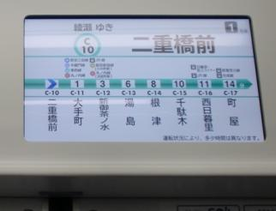
Liquid Crystals in Displays
Outline
- Liquid Crystals
- Building a Liquid Crystal Cell
- Liquid Crystal Display Pixel
- Passive/Active Matrix Addressing
Image in the public domain

Slide 2
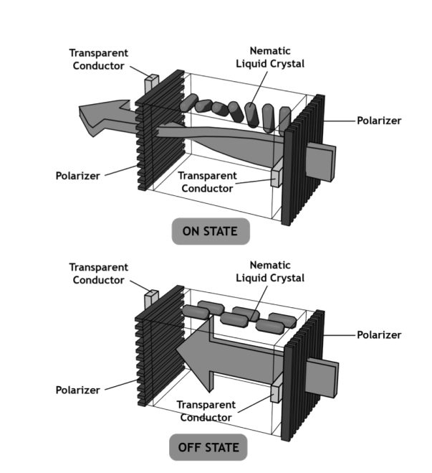
Liquid Crystal Displays
© Prentice Hall / Pearson PLC. All rights reserved. This content is excluded from our Creative Commons license. For more information, see http://ocw.mit.edu/fairuse.
How can a material rotate polarization ?
Figure 2.16 from Hearn and Baker

Slide 3


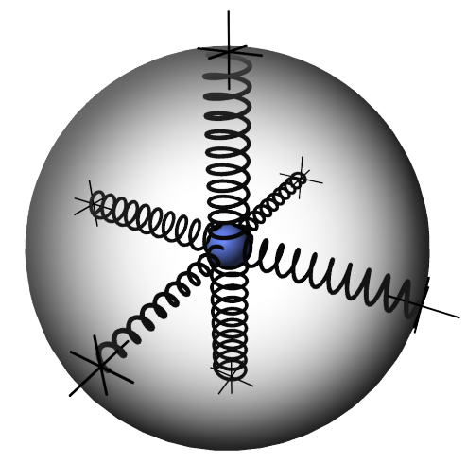




Anisotropic Material
The molecular "spring constant" can be different for different directions
If ,
then the material has a single optics axis and is called
crystal

Slide 4
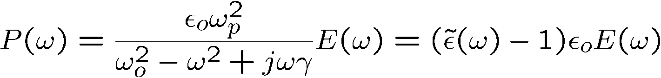


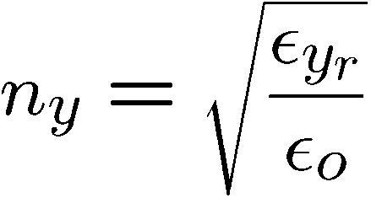
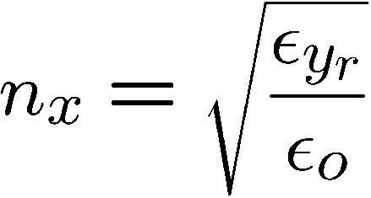

Microscopic Lorentz Oscillator Model
In the transparent regime
…

Slide 5
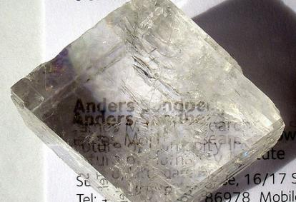
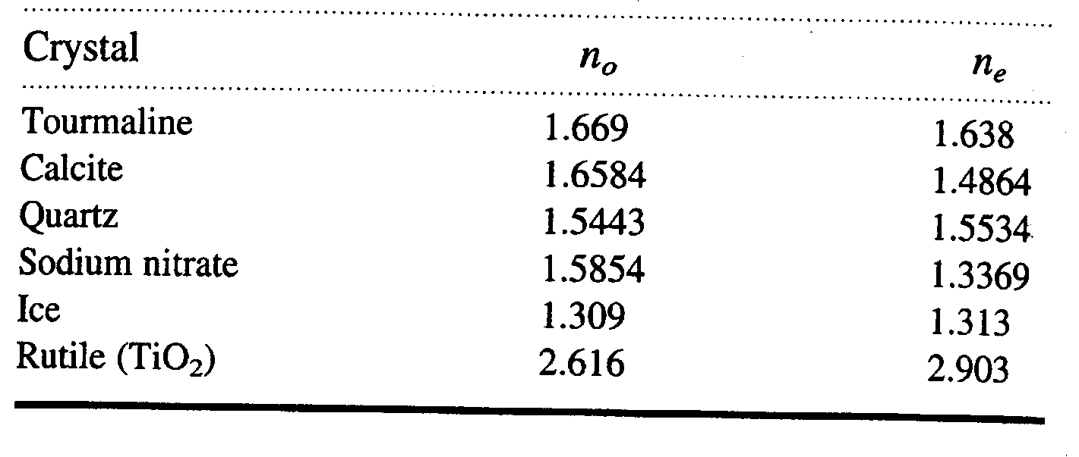

Birefringent Materials
o-ray
n_{o}
e-ray
n_{e}
Image by Arenamotanus http://www.flickr.com/photos/
arenamontanus/2756010517/ on flickr
All transparent crystals with non-cubic lattice structure are birefringent.

Slide 6
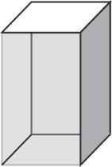

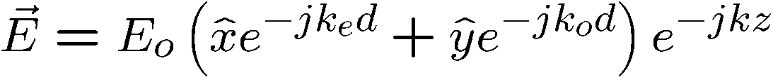
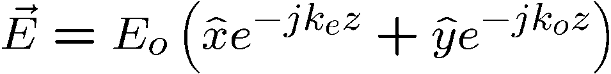
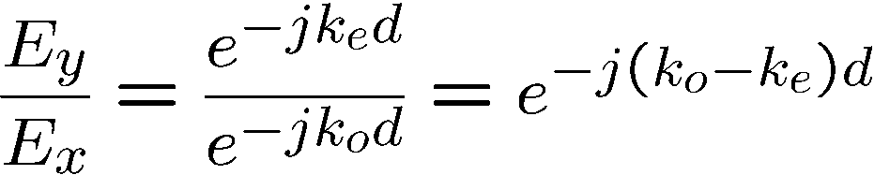
Polarization Conversion
Linear to Circular
inside
Polarization of output wave is determined by…

Slide 7
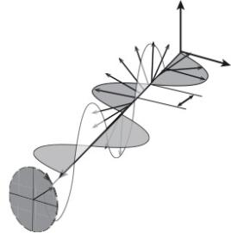
Quarter-Wave Plate
left circular
output
Circularly polarized output
45º
linearly polarized input
Example:
If we are to make quarter-wave plate using calcite (n_{o} = 1.6584, n_{e} = 1.4864), for incident light wavelength of λ = 590 nm, how thick would the plate be ?
d = 0.857 μm

Slide 8
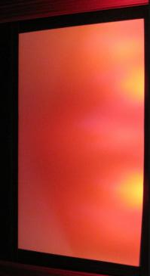
3D Movies Technology
Polarizer A
Left eye
source
Film or digital projector
Right eye
source
Film or digital projector
Polarizer B
Image by comedy_nose http://www.flickr.com/photos/comedynose/4482682966/ on flickr
Which approach is better ? Linear or circular polarization ?

Slide 9
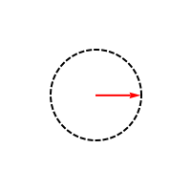
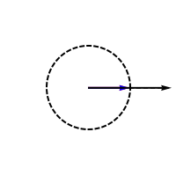
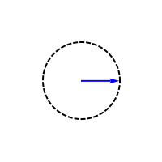
A linearly polarized wave can be represented as a sum of two circularly polarized waves
CIRCULAR
LINEAR
CIRCULAR

Slide 10
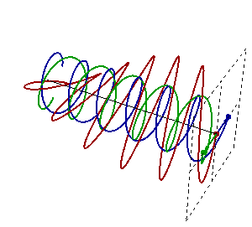
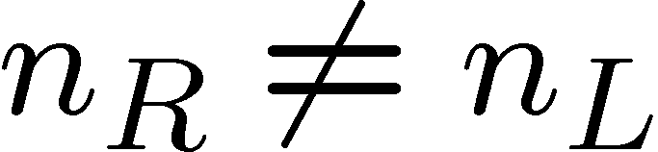
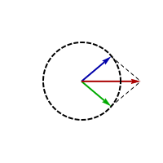
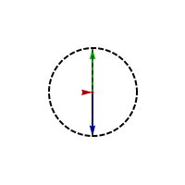
Circular Birefringence
But as the two circular polarizations of light travel through the circular birefringence material at different speeds, they will be phase shifted when they exit the medium

Slide 11
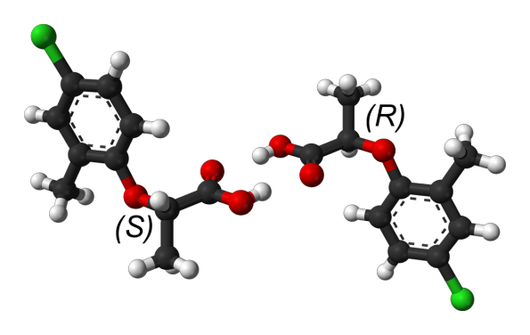
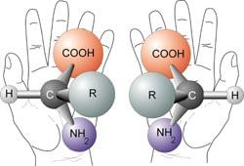
Circular Birefringence
Chiral molecules…
…different interactions with left- and right-
circular polarizations
All images in the public domain

Slide 12



Polarization Rotation with Circular Birefringence
x-polarized
y-polarized
-

Slide 13
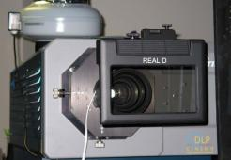
Interleaved 3D Movies
Shuttered/
switching polarizer
Left eye
source
High frame rate projector
Right eye
source
Image by comedy_nose http://www.flickr.com/photos/comedynose/4482682966/ on flikr

Slide 14
Liquid Crystal Displays
Circular birefringence
E = 0
NO circular birefringence
E = 0
© Prentice Hall / Pearson PLC. All rights reserved. This content is excluded from our Creative Commons license. For more information, see http://ocw.mit.edu/fairuse.

Slide 15
States of Matter
Solid (crystalline):
incompressible, no flow under shear
crystal = periodic in space
Liquid Crystal:
incompressible, flows under shear
long range order
Liquid:
incompressible, flows under shear
very short range order
Gas:
compressible

Slide 16
Liquid Crystal Structure
Steemers, SID Seminar Notes 1994.
Crystal
Increasing temperature
Liquid
Vapor
Liquid Crystal
melting
point
clearing
point
Temperature
Nematic
liquid crystal
Smetic
liquid crystal
Cholsteric
liquid crystal
- Molecules tend to be parallel but their positions are random
- Long range orientation order
- Positional order in 1-D
- Long range orientational order
- Distorted form of the nematic phase in which the orientation undergoes helical rotation
- Chiral molecules

Slide 17
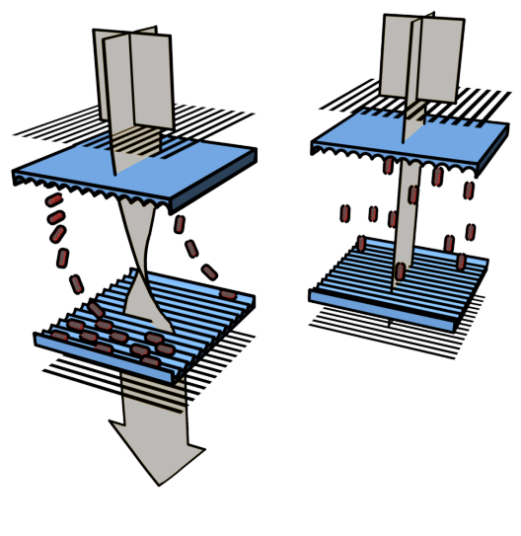
Twisting Liquid Crystals
LC ordering is determined by anisotropic boundary conditions (grooves)
Light
polarizers
S
Voltage
Alignment
layers

Slide 18
6.007 Lab Pixel
Polarizer
glass
ITO
-
PVA
Liquid crystal
spacer
beads
V
+
Polarizer
Polishing PVA (polymer) creates alignment grooves..
spacer beads
polishing
direction

Slide 19
Liquid Crystal Displays
E = 0
© Prentice Hall / Pearson PLC. All rights reserved. This content is excluded from our Creative Commons license. For more information, see http://ocw.mit.edu/fairuse.
LC dielectric anisotropy allows control of molecular orientation by the external E-field.
Molecules rotate to minimize stored energy
E = 0
What is the physical reason for LC rotation ?
Figure 2.16 from Hearn and Baker

Slide 20
Anisotropic Dielectric Constant
A
+
+
+
+
+
+
+
+
+
+
+
+
+
+
+
+
+
+
+
-
-
-
-
-
-
-
-
-
d
+
+
+
+
+
+
+
+
+
-
-
-
-
-
-
-
-
-
-
-
-
-
-
-
-
-
-
A
+
+
+
+
+
+
+
+
+
+
+
+
+
+
+
+
+
+
+
-
-
-
-
-
d
+
+
+
+
+
-
-
-
-
-
-
-
-
-
-
-
-
-
-
-
-
-
-

Slide 21
Energy Method for LC
A
+
+
+
+
+
+
+
+
+
+
+
+
+
+
+
+
+
+
+
-
-
-
-
-
-
-
-
-
Stored energy …
d
+
+
+
+
+
+
+
+
+
-
-
-
-
-
-
-
-
-
-
-
-
-
-
-
-
-
-
A
+
+
+
+
+
+
+
+
+
Force acts to increase capacitance …
+
+
+
+
+
+
+
+
+
+
-
-
-
-
-
d
+
+
+
+
+
-
-
-
-
-
-
-
-
-
-
-
-
-
-
-
-
-
-

Slide 22
Electro-Optic Response of Twisted Nematic Liquid Crystal Cell
T=90%
Relative Transmission
T=10%
Applied Voltage
LC cell is 5 μm to 10 μm thick
At 3 V applied dc-bias E–field is 3 to 6 kV/cm

Slide 23
Transient Response of Twisted Nematic Liquid Crystal Cell
Applied voltage
The response is not instantaneous. This limits the refresh rate!
Time
Tfall
Trise
Relative Transmission

Slide 24
Reflective LCD Display
… illuminated by external light (sunlight)
6
Reflective surface to send light back to viewer.
5
Horizontal filter film to block/allow through light.
4
Glass substrate with common electrode film (ITO) with horizontal ridges to line up with the horizontal filter.
3
Twisted nematic liquid crystals.
2
Glass substrate with ITO electrodes. The shapes of these electrodes will determine the dark shapes that will appear when the LCD is turned on. Vertical ridges are etched on the surface so the liquid crystals are in line with the polarized light.
1
Vertical filter film to polarize the light as it enters.

Slide 25
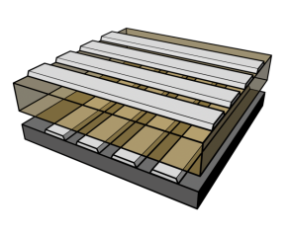
Display Addressing
DIRECTLY ADDRESSED
DISPLAY
MATRIX DISPLAY
HI
LO
Common
Electrode
v
Segmented
Electrode
DISABLE
ENABLE
Cathode Rows
Active
Layers
Example:
for X=640 x Y480 panel of emissive elements
direct addressing → 2 x 640 x 480 = 614,400 (2*X*Y) wires
matrix addressing → 640 + 480 = 1120 (X+Y) wires
Substrate
Anode Columns

Slide 26
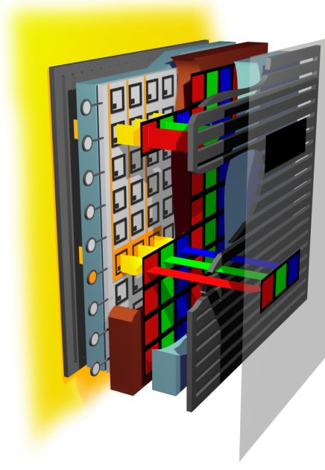
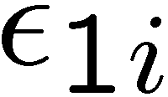
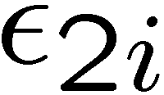

LCD Display Cross-Section
Fluorescent
backlight
Vertical
Polarizing filter
Column
Addressing line
Top polarizer
Retardation film
Top glass
Column electrodes
Liquid crystal
Row
Addressing
line
Row electrodes
Over coating
Color filter
Bottom glass
Retardation film
Subpixel
electrode
Bottom polarizer
Backlight
Example of a Color Filter (green)
Transistor
Pixel
ON
Glass plate
Front
plate
Liquid crystal
layer
Horizontal
Polarizing filter

Slide 27
LCD Backlight
Consists of light source, reflector, and diffuser
Goals are compactness, high efficiency, uniformity, long life
Fluorescent lamp
Display
Diffuser
Reflector
Display
TIR
refraction
BEF
lightpipe
ESR
Fluorescent
lamp

Slide 28


What is Color?
Image is in the public domain
Image is in the public domain
λ (m)
10²
10⁻¹
10⁻³
10⁻⁴
10⁻⁵
10⁻⁶
10⁻⁷
10⁻⁸
10⁻⁹
10⁻¹⁰
10⁻¹¹
10⁻¹²
10³
10¹
1
10⁻²
Radio waves
“Hard” X-rays
IR
UV
Microwaves
“Soft” X-rays
Gamma rays
Visible

Slide 29
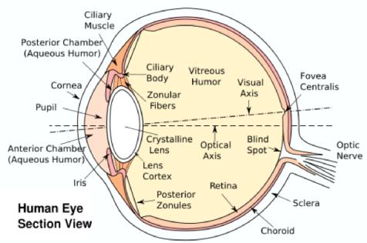
Diagram of the Human Eye
LIGHT
Retinal
Ganglion Cell
Bipolar Cell
Image is in the public domain
Retina has FOUR types of Receptors:
120 million Rods – brightness
6 million Cones – color
B 5-10% (“S-cones”)
G ~30% (“M-cones”)
R ~60% (“L-cones”)
Cone
Rod
The Neural Structure of the Retina

Slide 30
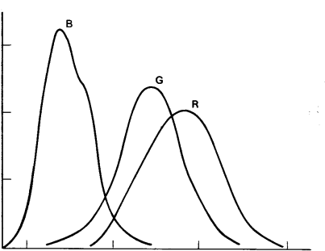
Spectral Sensitivity of Cones
L-cones have peak absorption at λ~560 nm
M-cones have peak absorption at λ~530 nm
S-cones have peak absorption at λ~430 nm
The three cones have broad sensitivity curves with a lot of overlap
Light at 550 nm will evoke response from L- and M- cones but much weaker response from S-cones
S
1.5
M
L
1.0
Relative Sensitivity
0.5
0
400
500
600
700
Wavelength [nm]

Slide 31
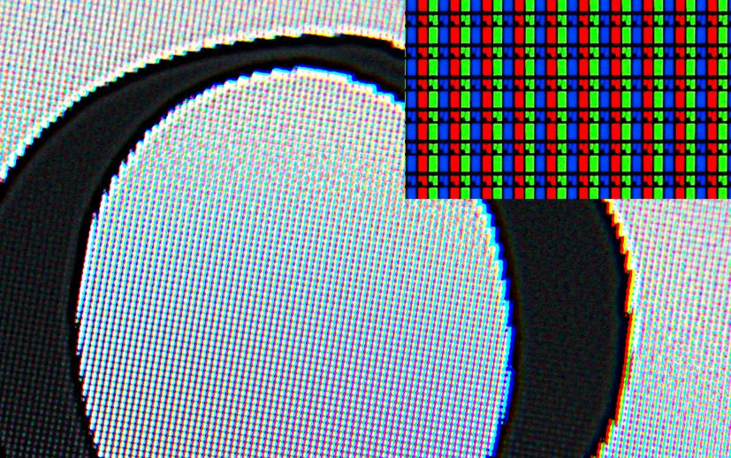
LCD under a Magnifier

Slide 32
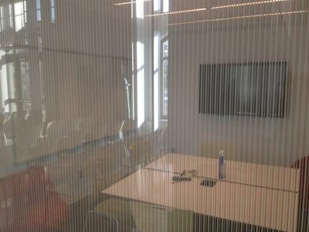
Polymer Dispersed LCDs – Privacy Glass
Image by University of Michigan MSIS http://www.flickr.com/photos/umich-msis/6443313259/ on flickr
suspension
liquid
Suspended
particle
conductive
coating
+
-
+
-
OFF
ON
A standard meeting room with some privacy protection
Polymer dispersed LCDs allow for changeable transparency
OFF

Slide 33
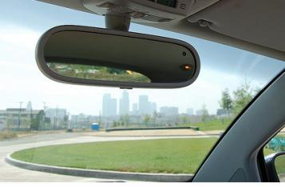
Electrochromic Windows
- Shift of the Lorentz Oscillator
- change Optical Absorption
When switched “OFF” and electrochromic window remains transparent.
When switched “ON” voltage drives the ions from the ion storage layer, through the ion conducting layer and into the electrochromic layer. Oxidation reaction -- a reaction in which molecules in a compound lose an electron changes the dielectric properties of the electrochromic layer, which now absorbs the incident light, are what allow it to change from opaque to transparent. It's these ions that allow it to absorb light. By shutting off the voltage, the ions are driven out of the electrochromic layers and into the ion storage layer. When the ions leave the electrochromic layer, the window regains its transparency.
Ion conductor/
Electrolyte
Ion storage
Electrochromic
layer
Conductor
OFF
glass
glass
Conductive layers
+
-
Image by Bitboy http://www.flickr.com/photos/bitboy/2388546266// on flickr
+
-
+
-
glass
glass
electrochromic
ON
+
-
+
-
+
-
+
-
A rear view mirror with an electrochromic layer for dimming during night time use

Slide 34
MIT OpenCourseWare
http://ocw.mit.edu
6.007 Electromagnetic Energy: From Motors to Lasers
Spring 2011
For information about citing these materials or our Terms of Use, visit: http://ocw.mit.edu/terms.

