Slide 1
12.010 Computational Methods of Scientific Programming
Tom Herring, tah@mit.edu
Chris Hill, cnh@mit.edu
Lecture 2: Hardware, Boolean algebra, Loops

Slide 2
Topics
Review of computer hardware and impact on programming
  What happens with “Hello World”
Starting basic concepts: Operators
  = assignment or binding (this is a critical concept in Python and varies between languages)
Suites: single blocks of code with header line; Branching and looping
Boolean Algebra:
  Logical tests
  And/or/xor: Truth tables
Loops:
  For loops
  While loops
Today’s class will get us to looking at the = operator.

Slide 3
Software to hardware
Most of this class is concerned with tools for writing software, i.e. programming.
Ultimately programs “execute” on computer hardware
Hardware imposes some limits of what a program can do, how a program works
This section looks at some basic hardware concepts that can be useful in understanding what limits it is useful to have in mind when programming.

Slide 4
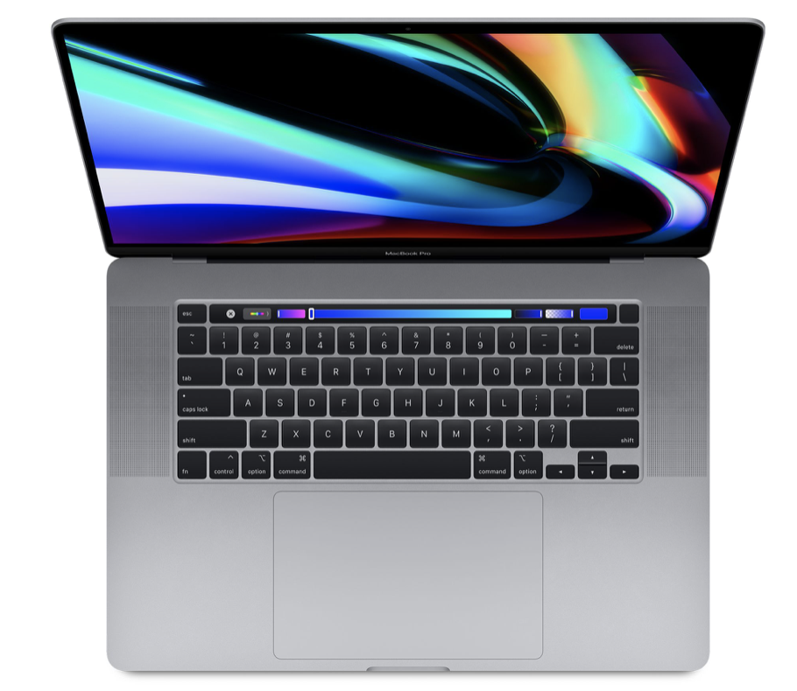
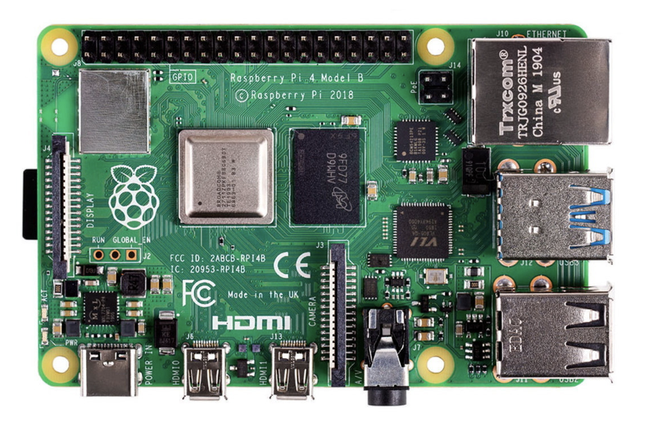
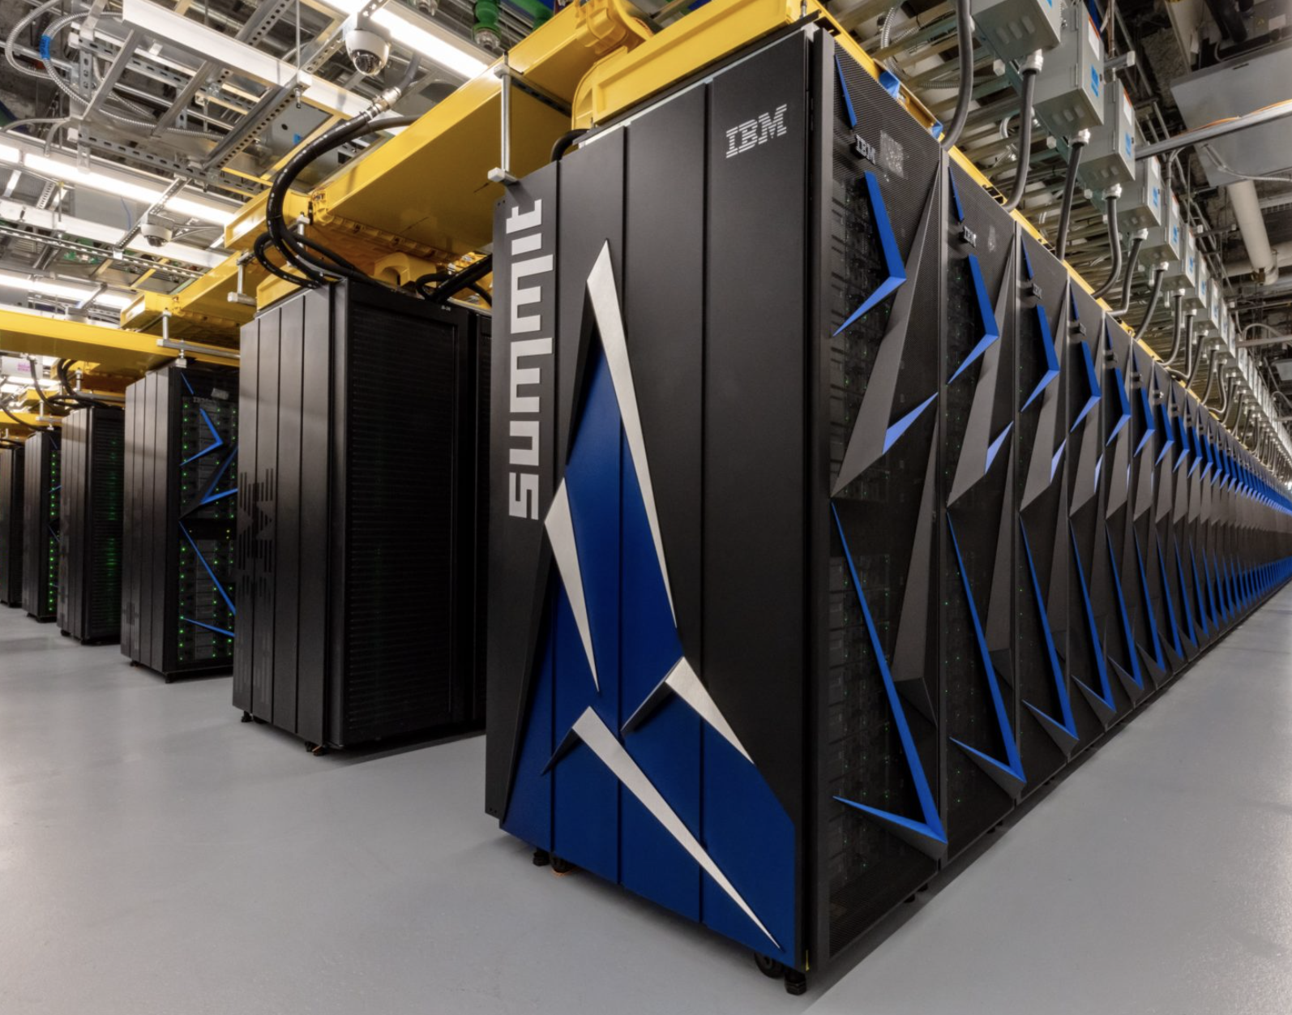
Modern computers all have similar hardware building blocks
Mac Laptop
Raspberry Pi 4
Summit Supercomputer
© Shenzhen Trxcom Electronics Co., Limited. All rights reserved.
This content is excluded from our Creative Commons license. For
more information, see https://ocw.mit.edu/help/faq-fair-use.
© 2025 Apple Inc. All rights reserved. This content is
excluded from our Creative Commons license. For more
information, see https://ocw.mit.edu/help/faq-fair-use.
Main hardware pieces are
CPU (Intel, AMD, IBM, ARM)
dynamic memory (RAM)
permanent storage (disk, SSD, memory card )
devices (network, graphics/GPU, screen, keyboard)
Image courtesy of DOE. Image is in the public domain.

Slide 5
Wireless network device
Dynamic Memory (RAM)
CPU
Ethernet network device
In programming most of the hardware details are “abstracted” away.
But physical limits (amount of memory, CPU speed) affect what is possible.
USB devices
Permanent storage (SD-CARD)
Video devices
© Shenzhen Trxcom Electronics Co., Limited. All rights reserved.
This content is excluded from our Creative Commons license. For
more information, see https://ocw.mit.edu/help/faq-fair-use.

Slide 6
CPU and memory
All computers have CPU and memory at their heart.
  A Python programming ultimately is transformed into a sequence of very basic instructions doing a few types of things
    Read some bits (1s and 0s) from memory into a local “register” on a CPU
    Combining or comparing different values in different “registers” (i.e. adding, multiplying, testing if less than or bigger than etc…)
      These computations all work with finite size, binary (sequences of 1 and 0) representations of information
    Updating values in ”registers”
    Write some bits from a register back to memory.
  There are variations on each of these steps, but at its heart all a CPU does is lots combinations of 1 – 4 over and over, at very high speed.

Slide 7
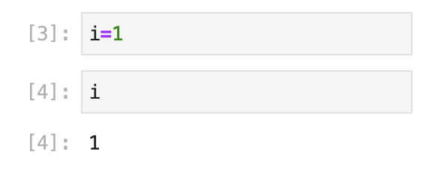
An example
CPU reads “instruction” from memory.
Memory
Python code
CPU
CPU writes value 1 to memory
…
0000000000000000000000000000001
In response to the Python above
Python interpreter will write CPU instructions to memory
CPU will read the instructions
CPU execute instructions
Note – 1 here is represented by 32-bits. CPU works in fixed sizes (16-, 32-, 64- bits. In Python, by default, an integer uses 32-bits.
In a modern CPU this is potentially happening billions of times per second.

Slide 8
Memory limits
Typical laptop had 16GB of memory.
  1 byte is 8 bits. 16GB is 16 x 10⁹ bytes or 1.28 x 10¹¹ bits.
  16GB is enough memory for 4 x 10⁹ 32-bit integers ➔ one matrix with 63,000 x 63,000
  Because the computer also stores instructions for program and for operating system and data for other programs. The actual limit is less.
  ➔ in reality, a laptop should be OK to work with matrices up to 2000 x 2000
  my laptop is OK with adding 40,000 x 40,000
  with 60,000 x 60,000 - very slow…..

Slide 9
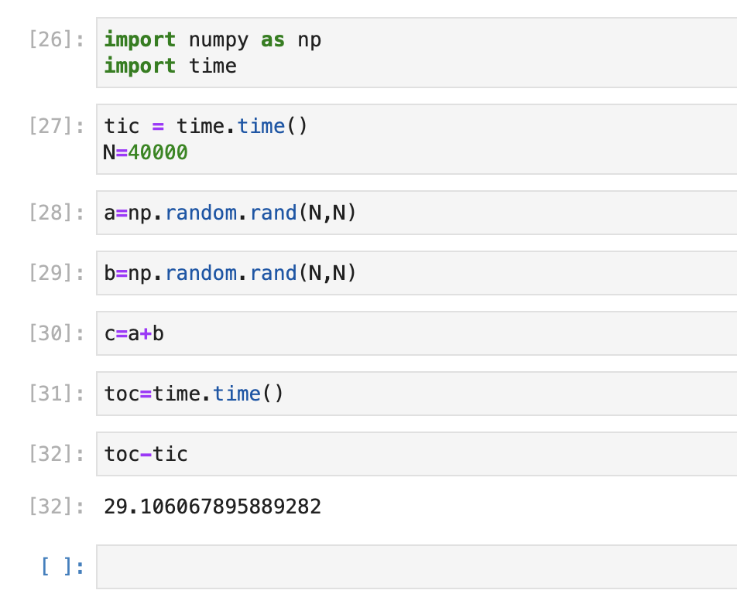
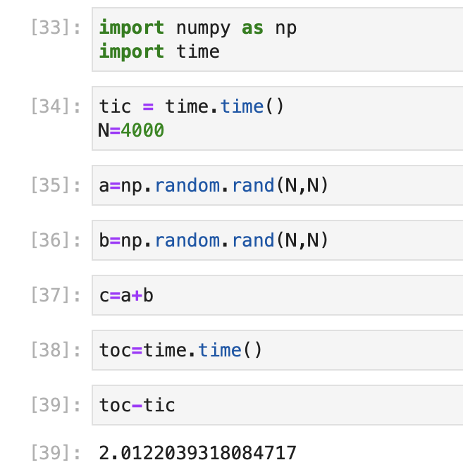
Memory usage and time*
4000 x 4000 => 122MB per matrix
40000 x 40000 => 11GB per matrix

Slide 10
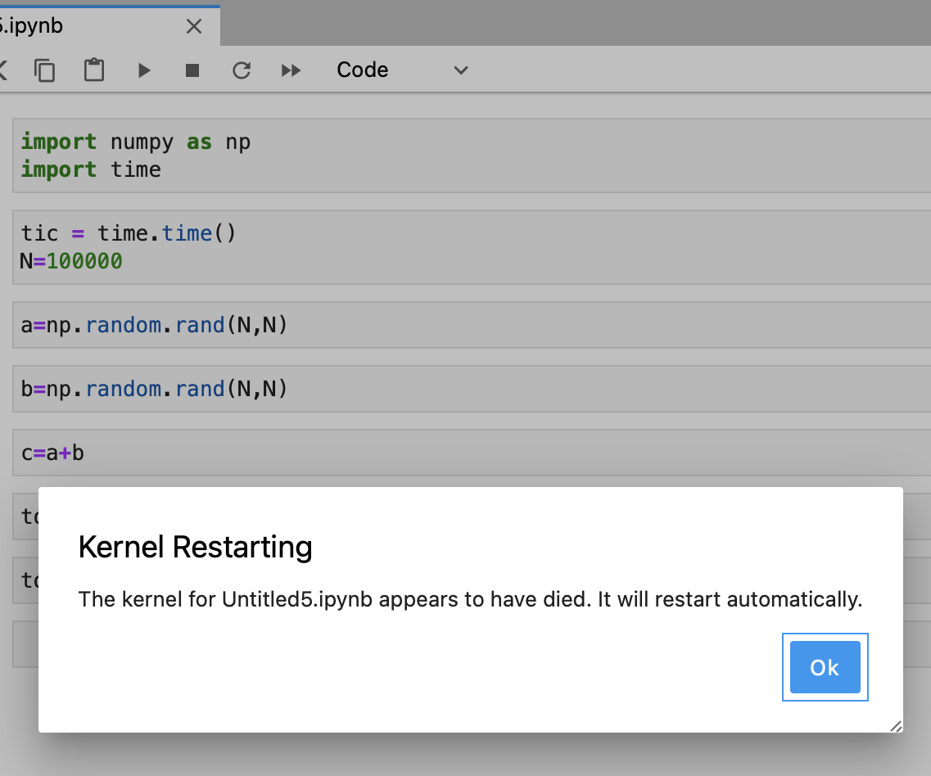
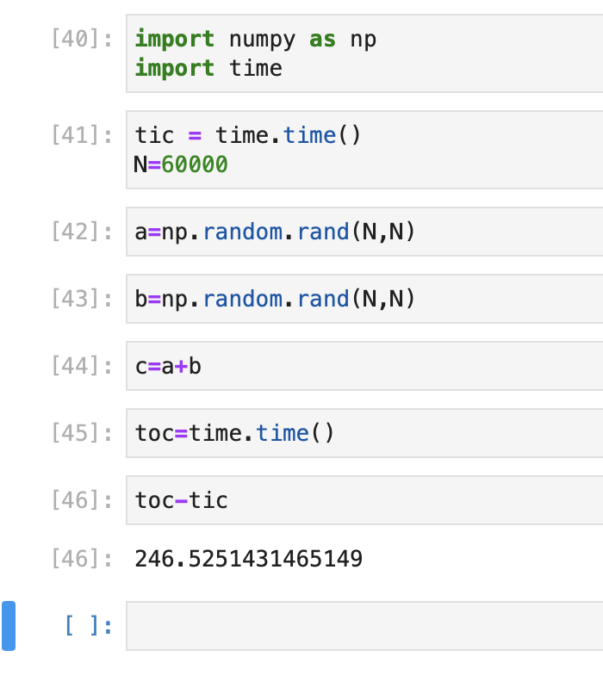
60000 x 60000 => 27GB per matrix
100,000 x 100,000 Python kernel dies!

Slide 11
Memory units
Variables
1 byte – 8-bits
1KB – 1024 bytes
1Kb – 1024 bits
1MB – 1024 x 1024 bytes
1GB – 2³⁰ bytes
1TB – 2⁴⁰ bytes
1 byte – ASCII character
4 bytes – integer, “single” precision float/real
8 bytes – “long” integer, “double” precision float/real
16 bytes – “quad” precision float/real
For all except ”quad” precision, a CPU will have dedicated circuits (transistors) for working with these sorts of data in “hardware,” i.e., optimized fast computation.

Slide 12
Number representation
CPUs can only compute fast on a few specific ways of representing information.
  Any other representations ultimately use these primitives. This will be slow because the primitives have to combine them in some way to emulate other representaions.
Key primitives
  1-byte characters and Booleans
  4-byte integers (32-bit)
  8-byte integers
  4-byte floating point
  8-byte floating point
For these types a CPU can typical a primitive operation (add/subtract, multiply, compare) in a few CPU clock cycles (typically 1 cycle is 1ns).

Slide 13
Integer numbers
Integer numbers can be represented exactly (up to the range allowed by the number of bytes)
A 2-byte integer, unsigned 0-65535, signed ±32767 (sometimes called short)
A 4-byte integer, unsigned 0-4294967295, signed ±2147483827
(With a 32-bit address bus, can have 4Gbytes of memory—reason max memory is limited in older computers. Nearly all machines are now 64-bit; still this designation in some software downloads)

Slide 14
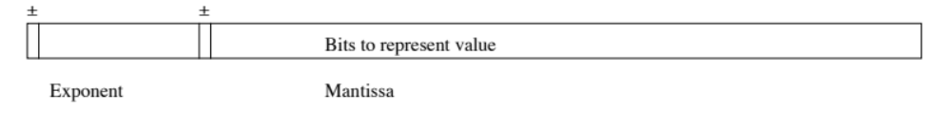
Floating point
Representations vary between machines (often reason binary files can not be shared).
Precise layout of bits depends on machine and format all formats are (mantissa)*2^(exponent). (Above is not IEEE, exponent is 2s-complement in IEEE) i.e., we think of powers of 10, but computer is powers of 2.
IEEE: 4-byte floating point is 8 bit exponent, 24 bit mantissa (1 sign bit for each), 7 significant digits, range 10±38
Notes:
Since the mantissa is 23 bits the largest number that can be represented is 2²³-1=8388607 which is approximately 10⁻⁷ thus 7 significant digits (we lose 1 bit for the sign). The largest exponent is 2⁷=128 and therefore the largest multiplies we can have is 2¹²⁸=3x10³⁸.
The impact of the number of significant digits is the errors that occur during numerical operations due to rounding error. For example, with 4-byte floating point numbers 100.0+10⁻⁷=100, the 10⁻⁷ is below the number of significant digits in 100.0

Slide 15
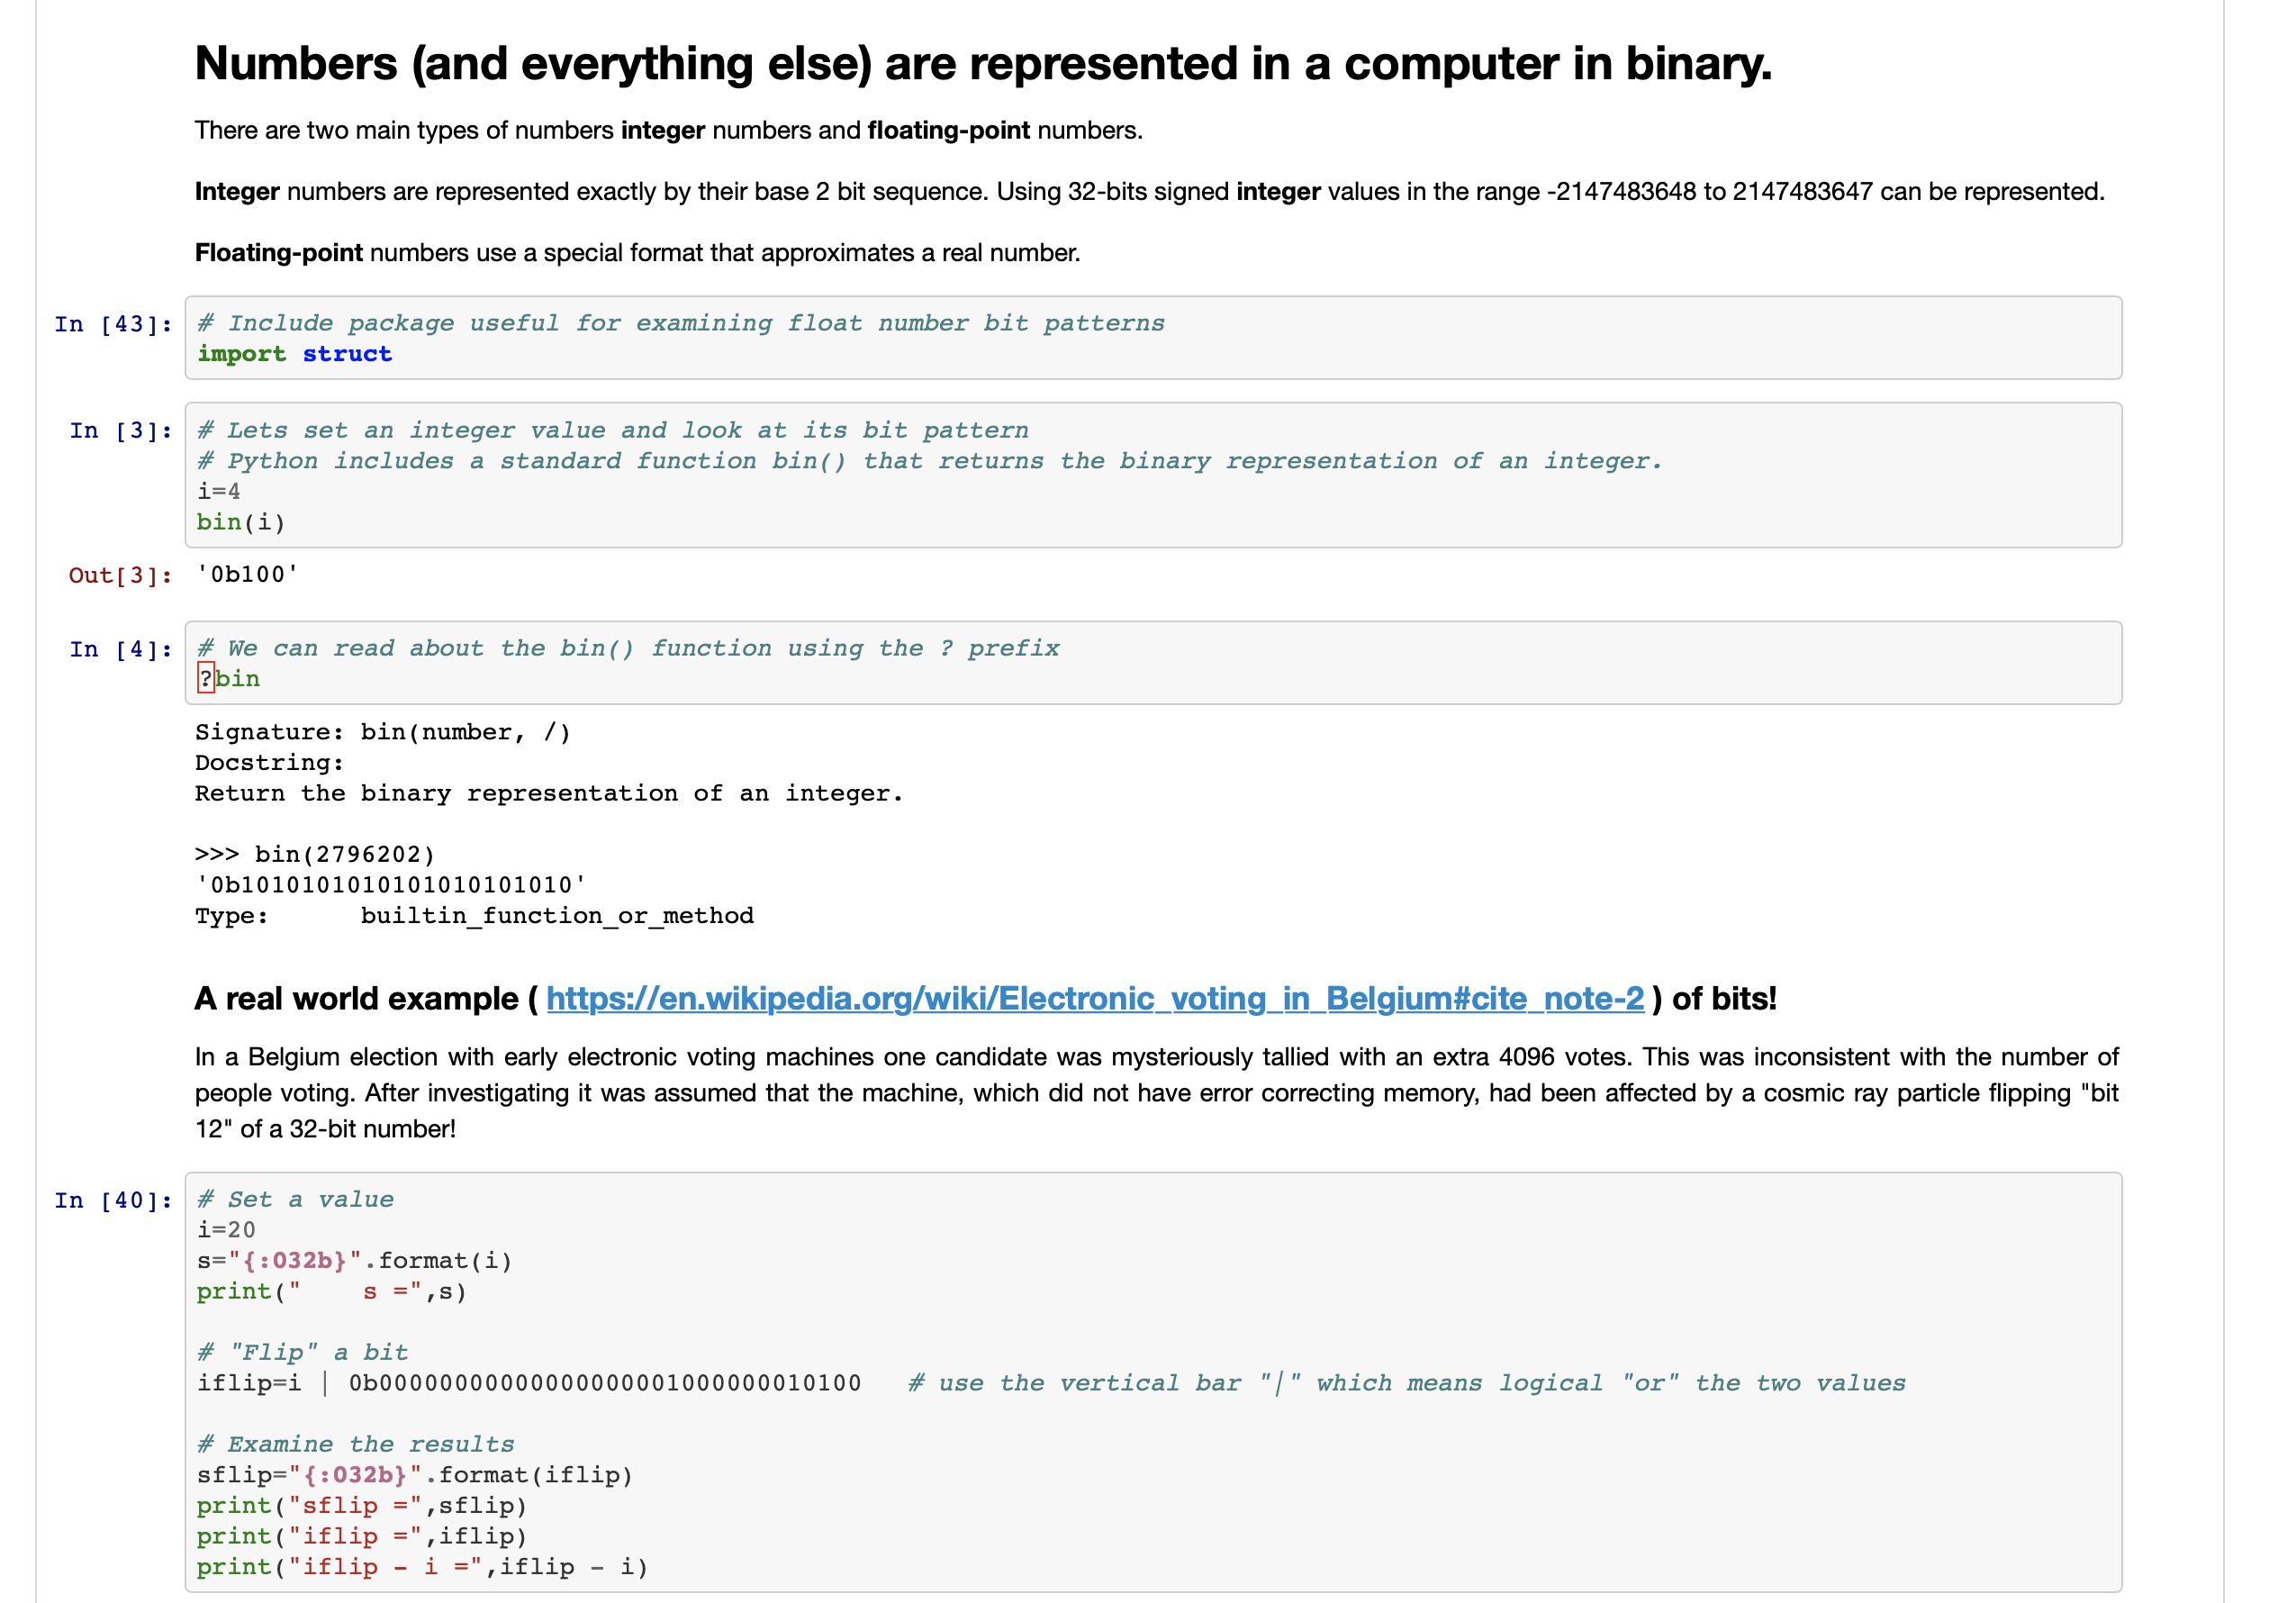
Hands on exercise
The Python notebook under
  https://github.com/christophernhill/fall-2022-12.010/tree/main/looking-at-bits
  contains some python code for exploring bit patterns in integers and floating point numbers.
There is Python in the exercise notebook ( "bit-int-float.ipynb" ) that may not be obvious yet. By the end of the class all the features will be explained.
For now we can explore and experiment with some of the code as is.

Slide 16
Operator groups in Python
Arithmetic operators
Assignment operators
Comparison operators
Logical operators
Identity operators
Membership operators
Bitwise operators
Other languages have similar types of grouping, but it does vary. Symbols for types of operations can differ and overlap
Material here based on https://www.w3schools.com/python/python_operators.asp

Slide 17
Arithmetic operators
Operator | Name | Example
+ | Addition | x + y
- | Subtraction | x - y
* | Multiplication | x * y
/ | Division | x / y
% | Modulus | x % y
** | Exponentiation | x ** y
// | Floor division | x // y

Slide 18
Assignment operators*
= is the assignment or binding operator. All operators can be used ?= form. Binding can be though of memory location assignment.
a=b=c=0 # form is also allowed. (operator= form does not work here but there are other subtle effects of op= in terms of binding.
a,b = 1,2 # acceptable use of assignment statement
Operator | Example | Same As
= | x = 5 | x = 5
+= | x += 3 | x = x + 3
-= | x -= 3 | x = x - 3
*= | x *= 3 | x = x * 3
/= | x /= 3 | x = x / 3
Notes:
To Here 23/09/12.

Slide 19
Summary
Review of computer hardware and impact on programming
  What happens with “Hello World”
Starting basic concepts: Operators
  = : assignment or binding
Focus on the difference between assignment and binding.

Slide 20
MIT OpenCourseWare
https://ocw.mit.edu
12.010 Computational Methods of Scientific Programming, Fall 2024
For more information about citing these materials or our Terms of Use, visit https://ocw.mit.edu/terms.

