Slide 1
12.010 Computational Methods of Scientific Programming 2021
Lecture 7: ODE solutions

Slide 2
Summary
Ordinary differential equation (ODE) solutions:
Methods from scipy
Methods from scratch.

Slide 3
ODE solvers
ODE solvers like odeint() are powerful for solving all sorts of differential equations involving gradients with respect to a single variable.
Interesting examples include
  Lorenz equations – a toy model for thinking about atmospheric predictability
  Lotka-Volterra equations – a toy model for thinking about predator-prey cycles in ecosystems
  Ballistic equations – the trajectory of golf ball or rocket
We can solve these systems ourselves using simple methods (e.g., Euler forward), but in general, an ODE solver will have smart techniques to automatically preserve accuracy as well as it can.

Slide 4
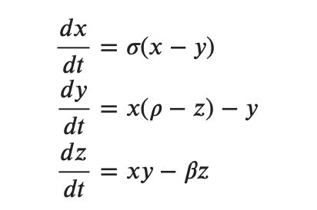
ODE solvers – DIY approach
To illustrate ODE solver concept we first code a simple solver explicitly by hand for the Lorenz63 equations
This set of equations was devised by Ed Lorenz (https://en.wikipedia.org/wiki/Edward_Norton_Lorenz ) at MIT in the 1960s, with computational help from Ellen Fetter (https://en.wikipedia.org/wiki/Ellen_Fetter ).
The equations were devised as a simple model for reasoning about chaotic phenomena in atmospheric dynamics.
three state variables x, y and z that vary in time t with parameters rho, sigma and beta being used to explore model behavior.

Slide 5
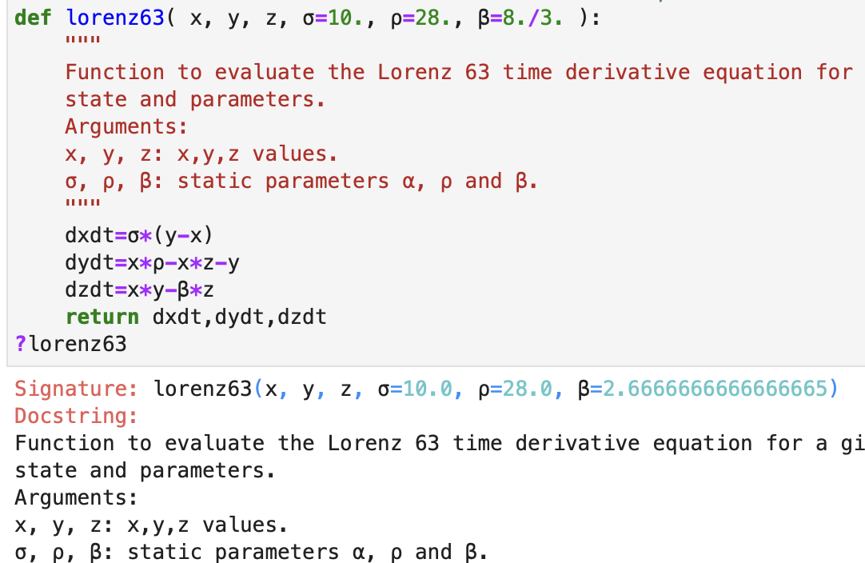
ODE solvers – DIY approach
  We can define a simple function for L63 equations
    Note use of docstring as a reminder for our future selves!

Slide 6
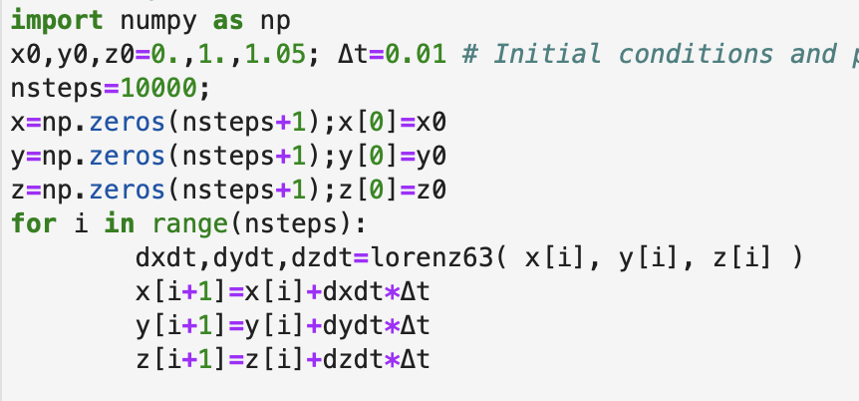

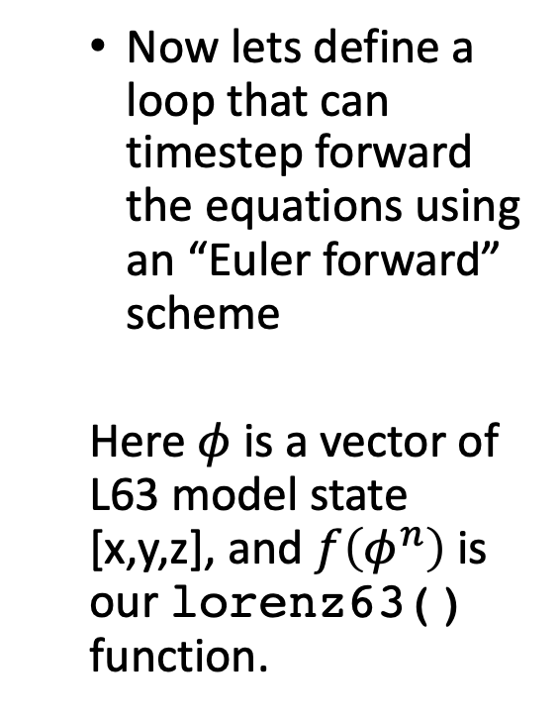
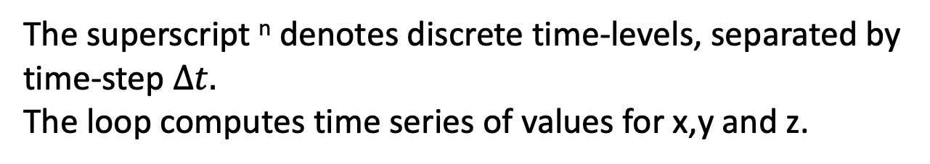
ODE solvers – DIY approach
  Now lets define a loop that can timestep forward the equations using an “Euler forward” scheme
  Here $φ$ is a vector of L63 model state [x,y,z], and $f\left(φ^{n}\right)$is our lorenz63() function.
The superscript ^{n} denotes discrete time-levels, separated by time-step $∆t.$
The loop computes time series of values for x,y and z.

Slide 7
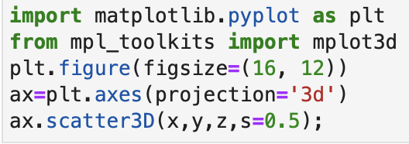
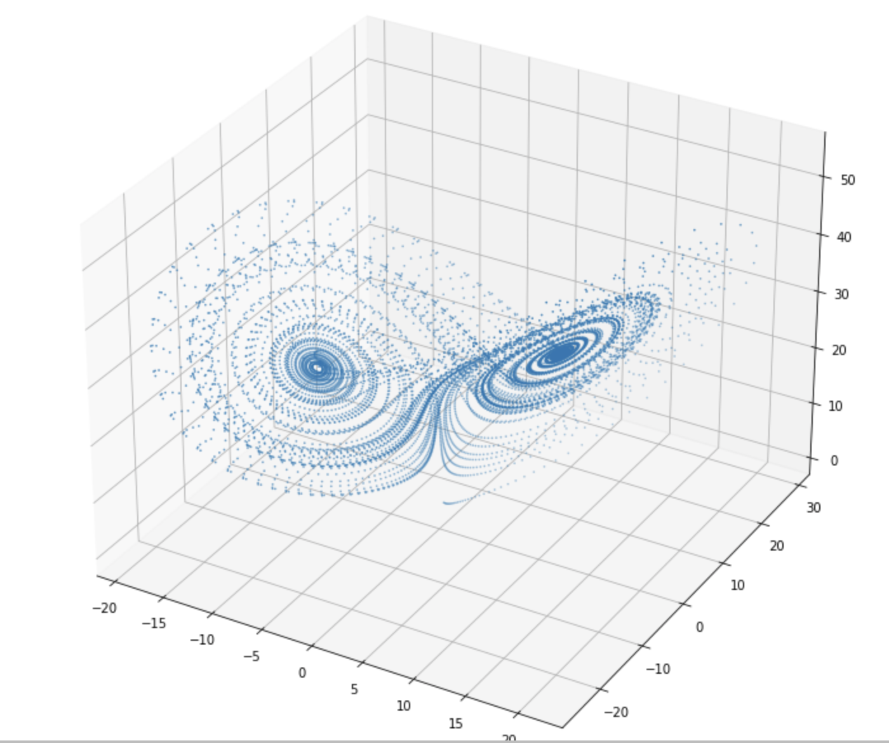
ODE solvers – DIY approach
  From the time series of values of x, y,z we can plot the solution
  Note – for some reason there is no plt.scatter3D() function, so we have to use a function tied to the axes object.

Slide 8
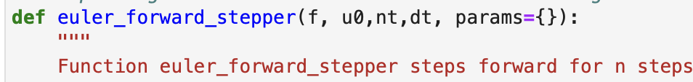
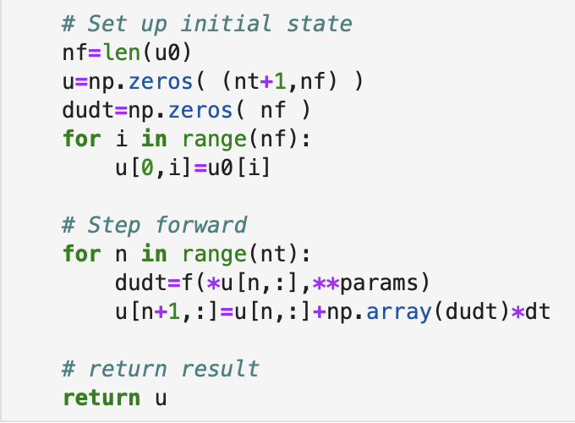
ODE solvers – DIY approach
  To make this more like “odeint” we can create a “stepper” function that can operate on any function that return derivatives.
  In this case, the stepper function evaluates the Euler forward loop.

Slide 9
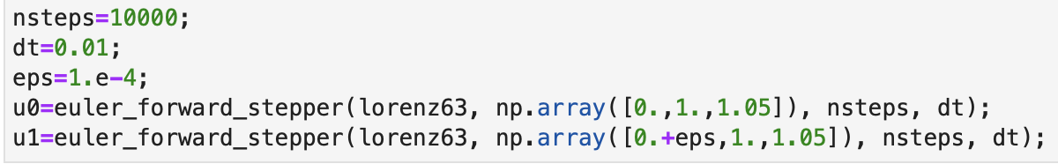
ODE solvers – DIY approach
  Now we can pass the lorenz63() function into the euler_forward_stepper() “black-box”
  We can sun the model twice, for slightly different initial conditions
This will step forward the ODE a specified number of steps using an Euler forward method from some initial state. The DIY stepper has a fixed timestep and a fixed method.
odeint is similar but it has more internal smarts to select timesteps and methods.

Slide 10
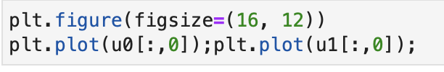
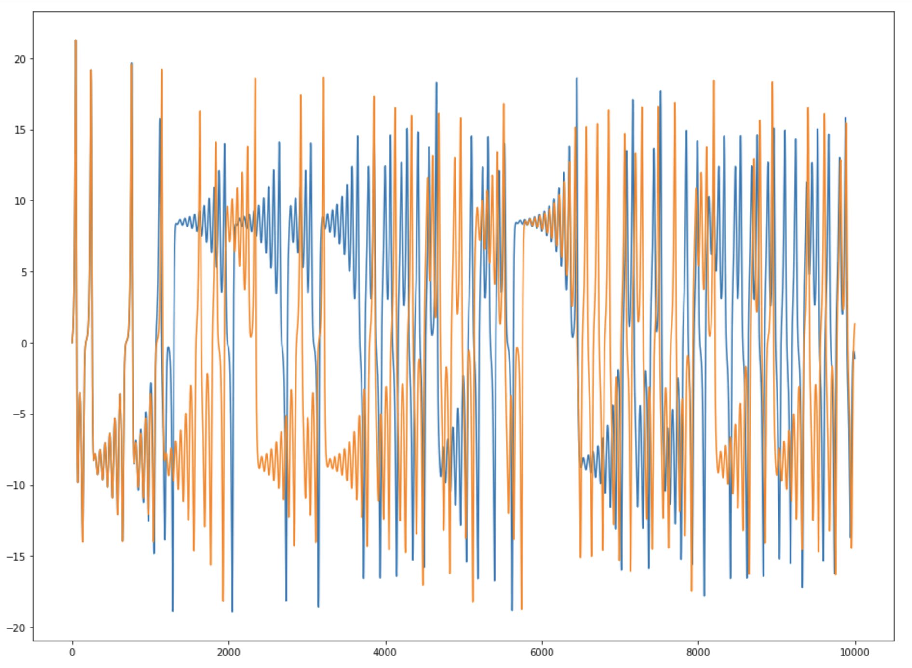
ODE solvers – DIY approach
  Finally we can plot the solution for two very close sets of initial conditions.
  The solution tracks closely for some time but then diverges significantly.
  This is a major reason why forecasting the weather (especially beyond 14 days) is hard!

Slide 11
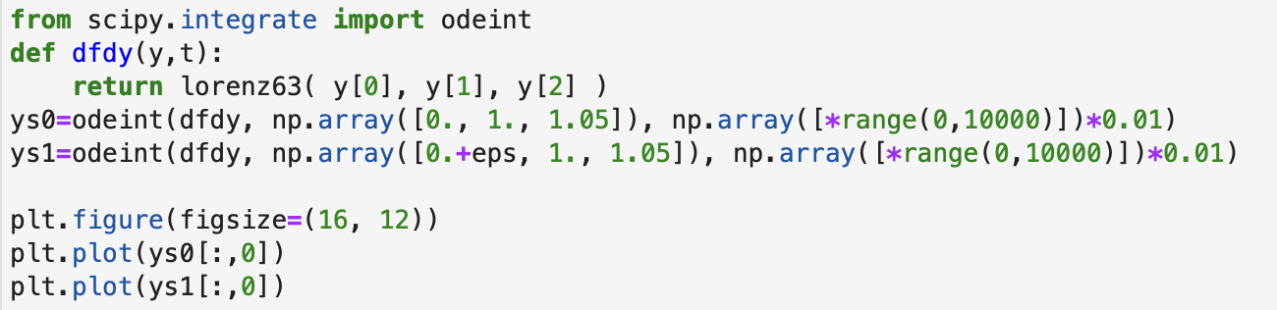
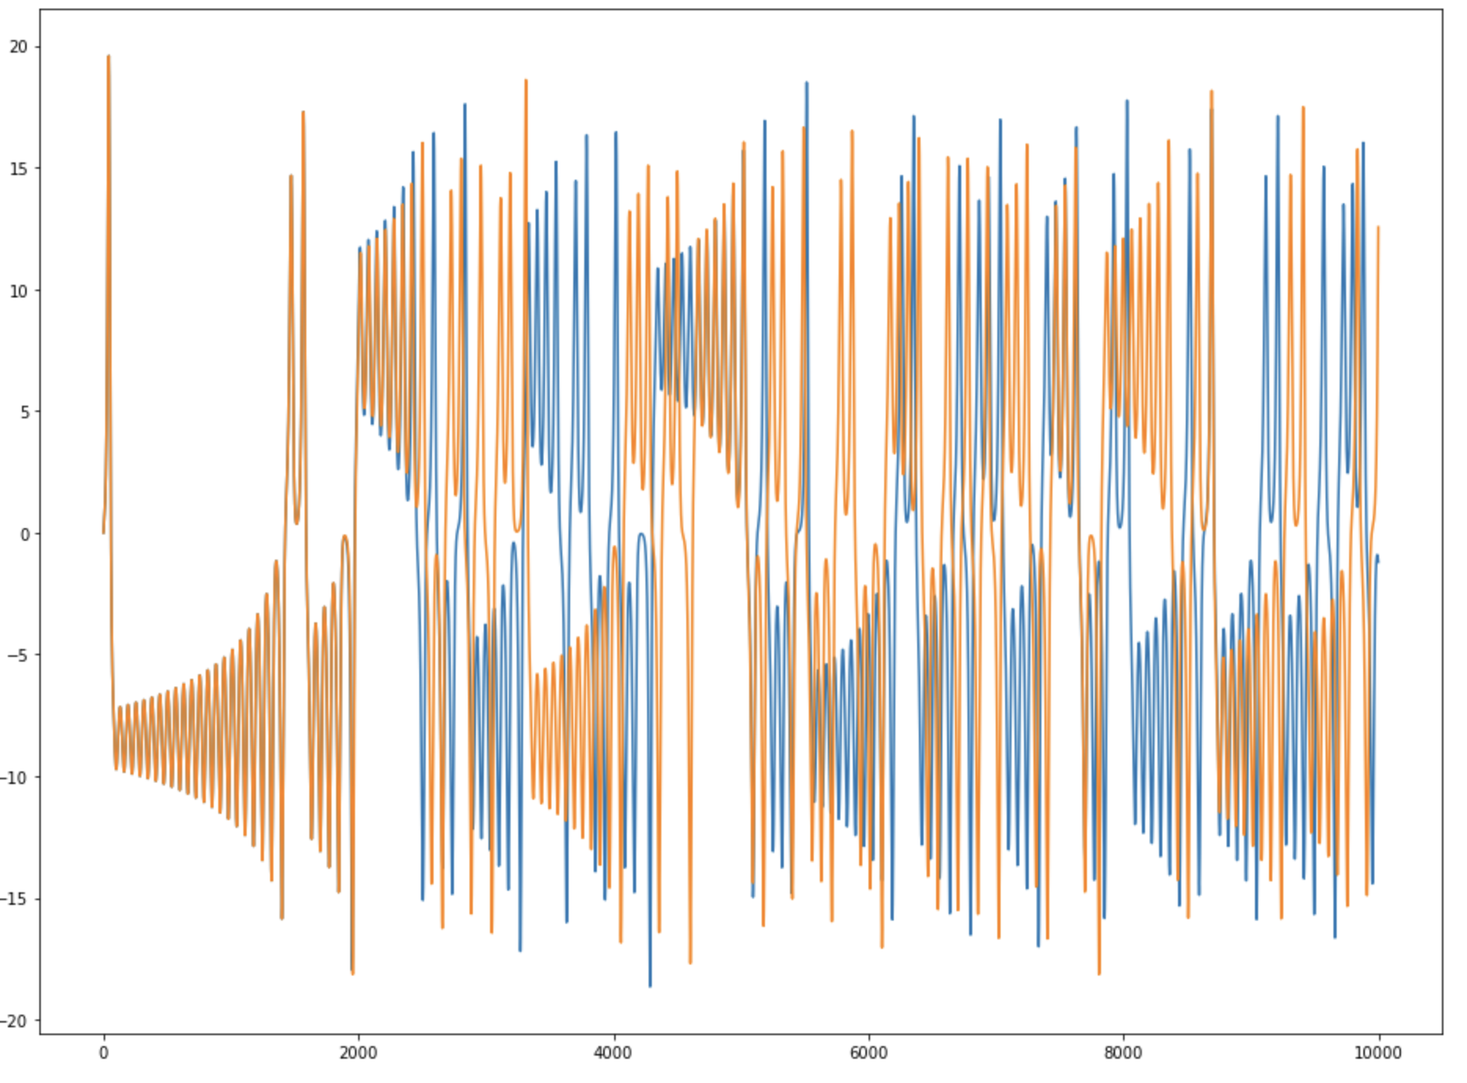
ODE solvers – using Scipy
  DIY ODE solver is OK, but -
  May be unstable for longer timesteps.
  Only has one method
  The method is not very accurate, so it requires a small timestep
  scipy.integrate.odeint() generalizes to allow more advanced methods, automated step size…
Note – the solution differs from the Euler forward DIY setup!

Slide 12
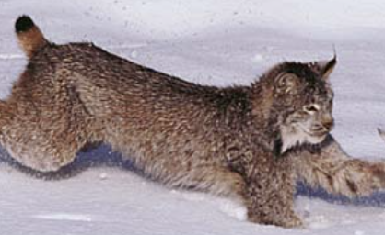
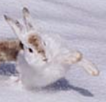
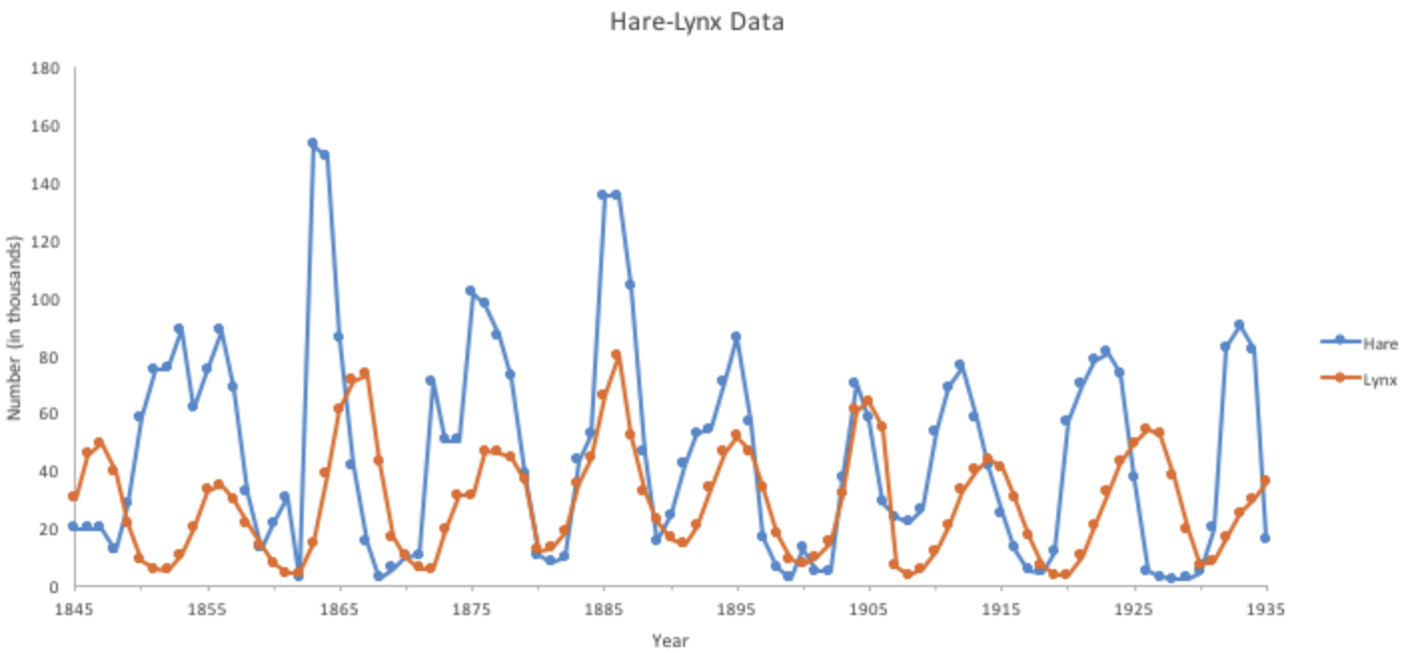
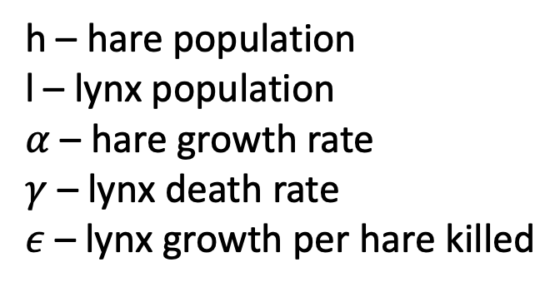
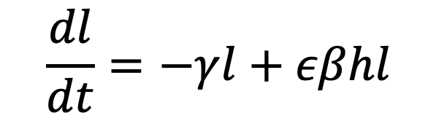
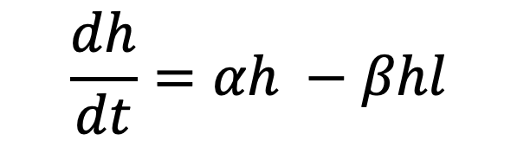
ODE solvers – using Scipy
  Now we can play with any ODE equations numerically
  e.g predator-prey model (Lotka and Volterra – 1925, 1926)
$$\frac{dh}{dt}=αh −βhl$$
The images of the lynx and the snowshoe hare © Tom and Pat Leeson.
All rights reserved. This content is excluded from our Creative Commons
license. For more information, see https://ocw.mit.edu/help/faq-fair-use.
$$\frac{dl}{dt}=−γl+εβhl$$
h – hare population
l – lynx population
$α$ – hare growth rate
$γ$ – lynx death rate
$ε$ – lynx growth per hare killed

Slide 13
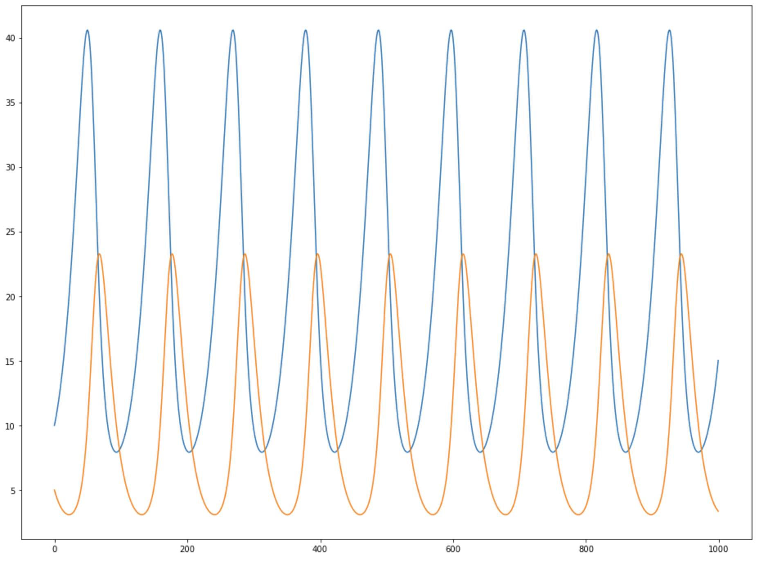
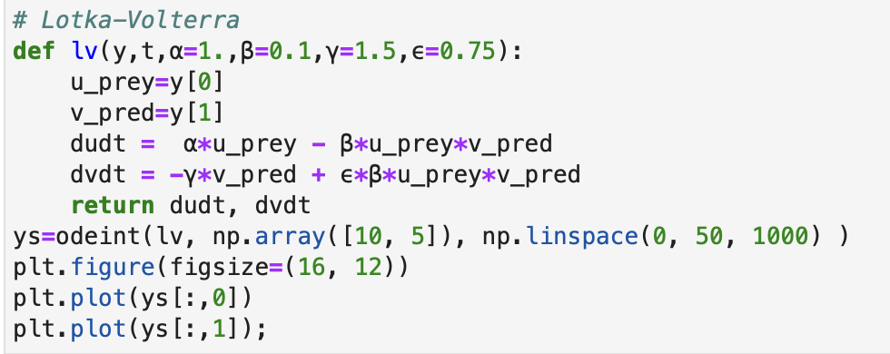
ODE solvers – using Scipy
Lotka Volterra code

Slide 14
ODE solvers – using Scipy
Try with notebook Lec08-ode.ipynb

Slide 15
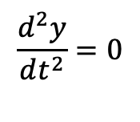
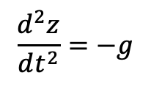
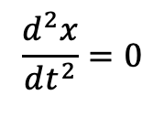
ODE solvers – starting from scratch
Consider throwing a ball
z
$$\frac{d^{2}z}{dt^{2}}=−g$$
1. No friction (in a vaccum!).
y
$$\frac{d^{2}y}{dt^{2}}=0$$
$$\frac{d^{2}x}{dt^{2}}=0$$
x
g
Lets try and write code to calculate the trajectory.

Slide 16
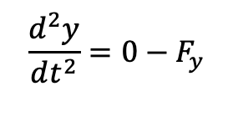
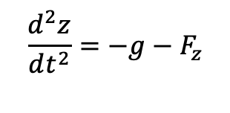
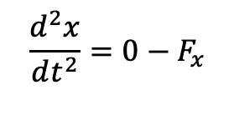
ODE solvers – starting from scratch
Consider throwing a ball
z
2. With friction for F = (F_{x} , F_{y} , F_{z} )
$$\frac{d^{2}z}{dt^{2}}=−g−F_{z}$$
y
$$\frac{d^{2}y}{dt^{2}}=0−F_{y}$$
$$\frac{d^{2}x}{dt^{2}}=0−F_{x}$$
x
g
Lets try and write code to calculate the trajectory.

Slide 17
Summary
Ordinary differential equation (ODE) solutions:
  Introduce new variables for second—and higher-order derivatives. For example, for an acceleration equation, add velocity as a variable.
Methods from scipy
Methods from scratch.

Slide 18
MIT OpenCourseWare
https://ocw.mit.edu
12.010 Computational Methods of Scientific Programming, Fall 2024
For more information about citing these materials or our Terms of Use, visit https://ocw.mit.edu/terms.

