Slide 1
12.010 Computational Methods of Scientific Programming
Lecture 9: Graphics continued and GUIs

Slide 2
Overview
Continue looking at different types of plots
Interacting with graphics:
  Backend specification
  ginput
  widgets

Slide 3
Interactive graphics and GUIs
Graphic user interface (GUI) and interaction with graphics needs to change from inline graphics.
Generally, virtual machines will not be able to display or use interactive capabilities.
The “backend” used sets the behavior and can changed to allow interactive plots.
We will look at matplotlib widgets here. Tkinter is a common GUI package, but we will not use it here (it needs additional conda installations).
ipywidgets are Jupyter widgets.

Slide 4
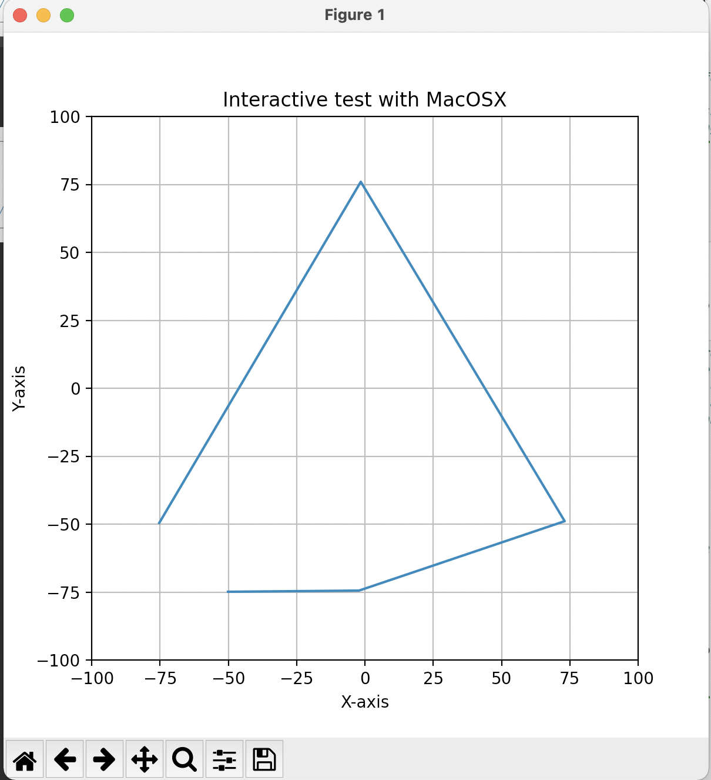
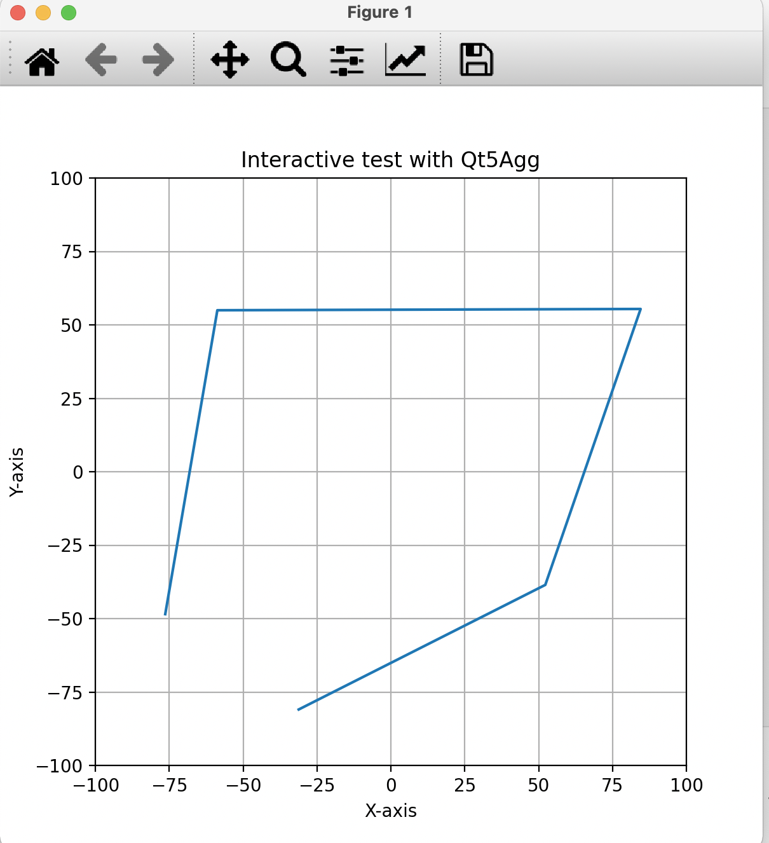
Backends*
macosx and qt5agg (screen shots): Uses ginput()

Slide 5
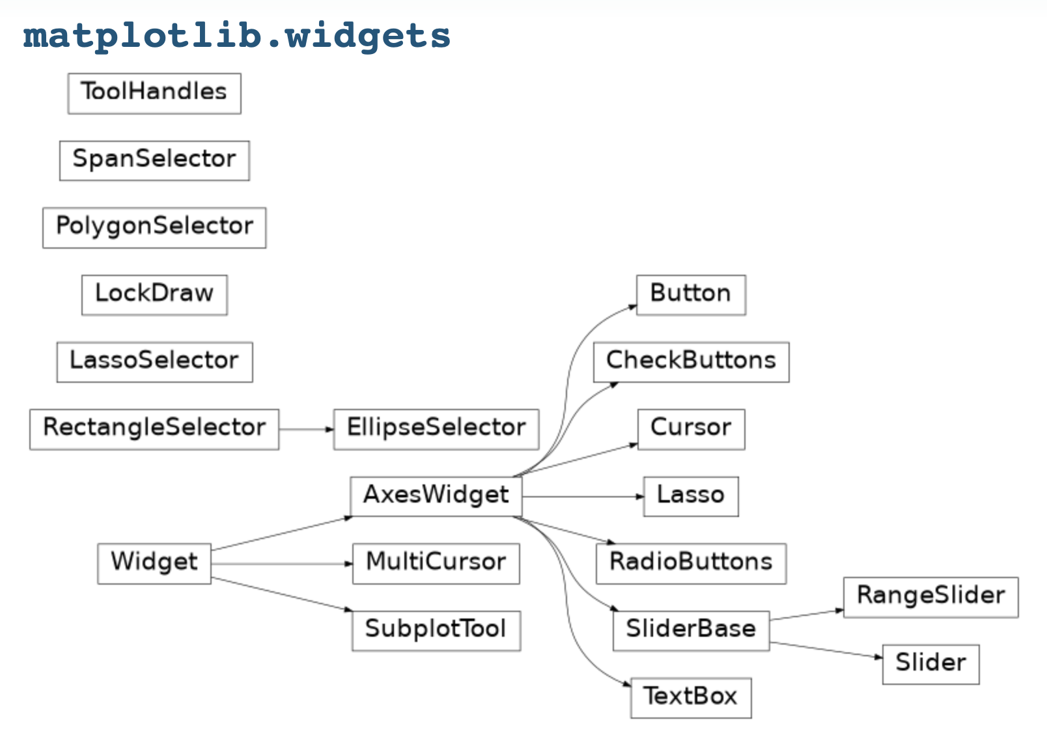
Matplotlib widgets
Widgets available. The widgets require a set of axes be defined the widget to be displayed in and to test for event.

Slide 6
Example widgets and animations
The notebook for this class includes examples of common types of GUI widgets.
The basics concepts of using widgets are:
  Create a fig,ax = plt.subplot()
  For manipulating a line plot with the widget (e.g., change colors, change ydata) create initial line
  line, = ax.plot(…)
  Creates a ‘line’, the ‘,’ is needed to get the line and not the line object
  Need to adjust position of axes to make room for widgets
  Create axis region for button/slider
  rax = plt.axes([x,y,width,height],..) Units are proportions of plot
  Create the widget object
  radio = RadioButtons(rax,…)
  Action:
  radio.on_clicked(<function to call). Function has line.<line methods>)
  Report button, slider codes for each operation needed.

Slide 7
Examples:*
Notebook has examples of:
  Slider and buttons
  Radiobuttons
  Textbox (and Python eval function)
  Ellipse region selector
  Simple animations: introduces new keyword yield and the concepts of iterable and generators (generators are useful for large lists that are only used once)

Slide 8
IPyWidgets
These widgets work in a Jupyter (and vscode) Notebook.
Graphics and widgets can be kept inside Notebook rather than external figure.
However ginput does not work in these figures
Examples: Lec10_ipywidgets.ipynb

Slide 9
Summary
Finished up looking at plot types
Looked at backends and the way matplotlib widgets can be used
Enough tools now to build a GUI that can read data from a URL (comma separated) and then have buttons to work with the data.

Slide 10
MIT OpenCourseWare
https://ocw.mit.edu
12.010 Computational Methods of Scientific Programming, Fall 2024
For more information about citing these materials or our Terms of Use, visit https://ocw.mit.edu/terms.

