Slide 1
12.010 Computational Methods of Scientific Programming
Lecture 14: Compiled languages

Slide 2
Summary
Start compiled languages:
Getting compilers (Fortran/C)
How they work (compile/link/run)
Goal is to give some basic familiarity and see how key foundational concepts (loops, conditionals, functions, data structures, I/O) look and behave.
  Fully learning each language in detail takes time and practice.

Slide 3
Compiled languages:
Is it worth learning more than Python?
  Great question!
  Python is getting remarkably capable e.g.
    https://veros.readthedocs.io/en/latest/
      Global ocean model (https://dionhaefner.github.io/2021/04/higher-level-geophysical-modelling/ ) all in Python, uses various packages (NUMBA, JAX) to allow
        NUMBA provides JIT (just in time) compilation for Python, which can make it perform well.
        JAX provides a plugin for GPUs
    In principle could just work in Python
  Lots of existing tools in Fortran, C, C++
    Exoplanets, seismic, fluids, ML, materials, econ etc…
    Knowing some can help make sense of these tools
  Also - Learning a little about other languages can help thinking overall, enhance understanding of concepts versus “implementation”.

Slide 4
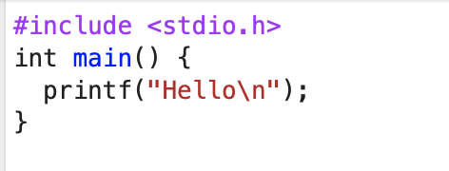
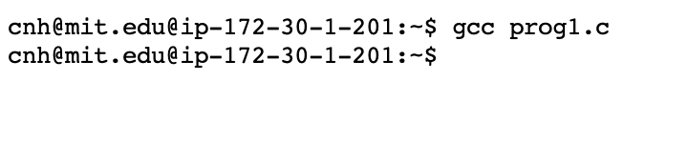
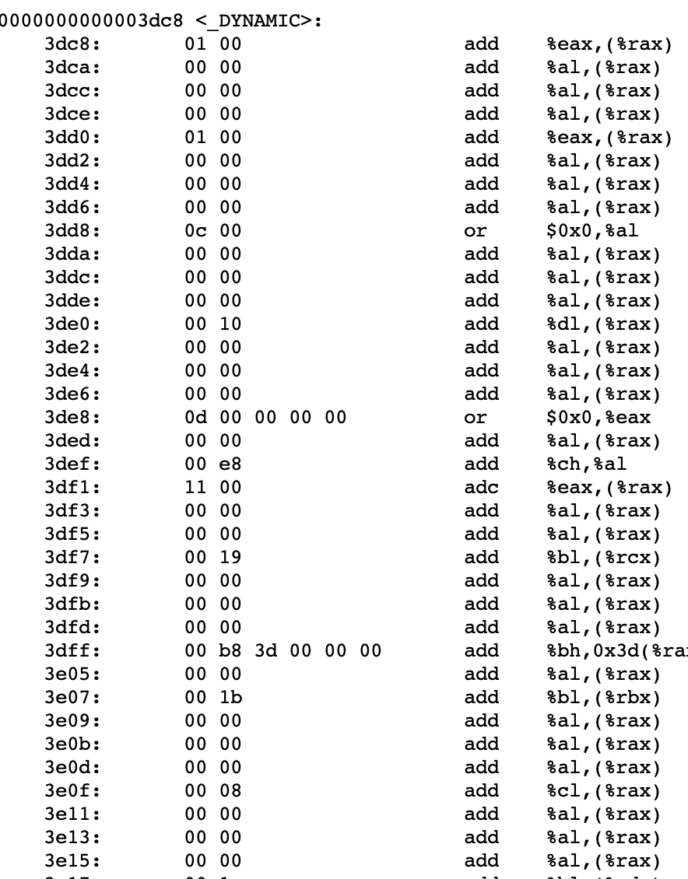
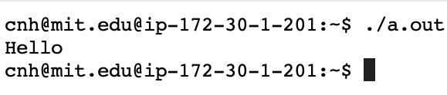
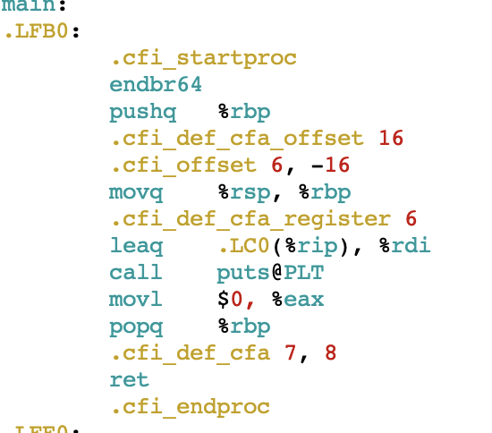
Compiled languages:
What does “compiled language” mean
  Using a compiled language means
  Code (C, Fortran, Java, C++) is written to a file (or files) in a human readable form
  The file(s) of code are processed by a special program, called a compiler.
  The compiler produces a separate file of output, called an executable.
  The executable is a program that can be run to perform the steps written in the original program
1. Write code
2. Compile code
4. Execute
cc1
as
ld

Slide 5
Compiled languages:
  Writing code
    uses a programming oriented editor e.g. vs-code, vi, emacs, nano, nedit etc….
  Compile and link code
    “compiles” one or more files into “object” code
      foo.c ➔ foo.o, bar.c ➔ bar.o
    “links” .o files to create executable (default name a.out ?)
      *.o ➔ a.out
1. Write code
2. Compile code
4. Execute
cc1
as
ld

Slide 6
Compiled languages v. interpreted - I
  What are some differences between compiled and notebook/Python (i.e., interpreted languages).
    Compiled code can be shared as a single binary file (for particular CPU + OS) and will execute.
    Interpreted code requires an “interpreter” program (e.g., Python)
    Developing with compiled code is generally more “pedantic”. Compiled languages quite often have more syntax rules, and the workflow is less interactive (harder to see what is going on, debugging requires more planning).
    Compiled code can often produce faster, more efficient and smaller programs (not guaranteed!)

Slide 7
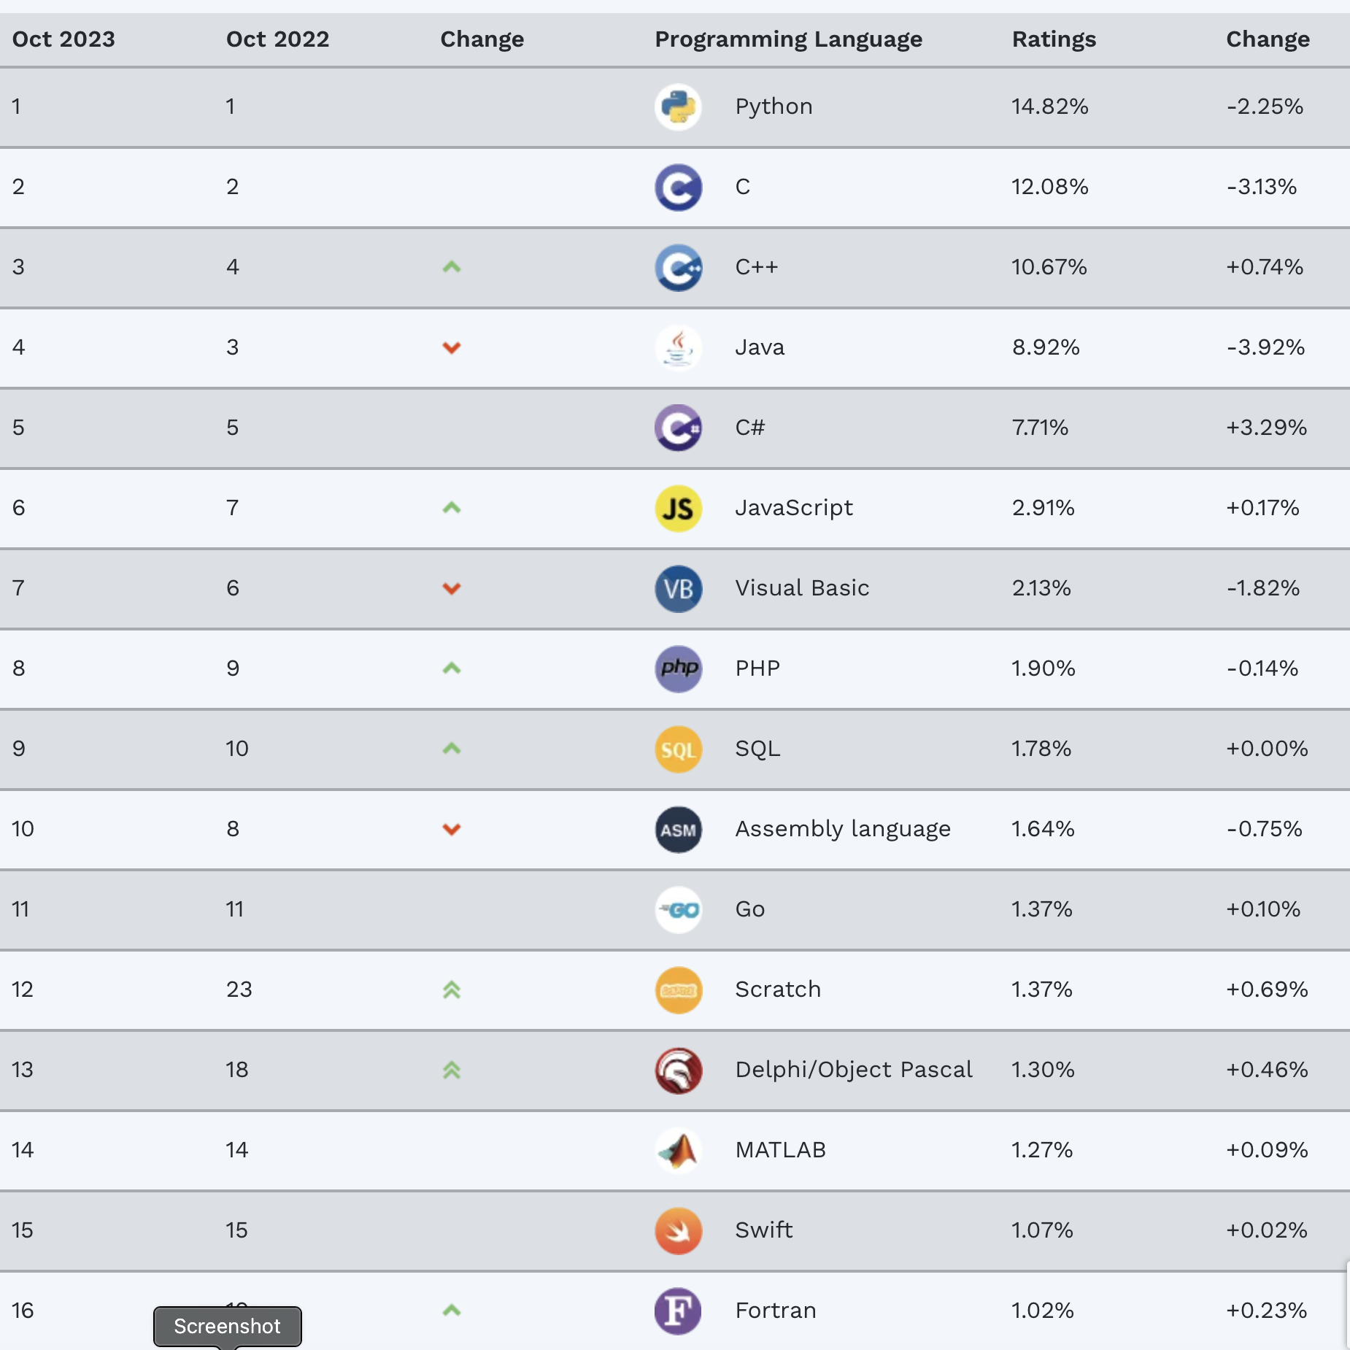
Compiled languages and uses
  Top 20 languages (https://www.tiobe.com/tiobe-index/ ) for 2021 has eleven compiled and nine interpreted
    C(2), Java(4), C++(3), C#(5), VB(7), AS(10), Go(11), Swift(15), Fortran(16), Pascal(?)
    Python(1), Javascript(6), SQL(9), PHP(8), MATLAB(14), R(17), Ruby(19), Perl(?)
  Compiled used for e.g.
    Operating system, Weather forecast models, planetary, stellar, geophysics, astro, mech, particle, real-time control etc…
  Interpreted also used, and growing
  Line between compiled v. interpreted can be blurred
    Can get interpreters for compiled langs
    Can “compile” interpreted langs!
© 2025 Tiobe Software BV. All rights reserved. This content
Is excluded from our Creative Commons license. For more
information, see https://ocw.mit.edu/help/faq-fair-use.

Slide 8
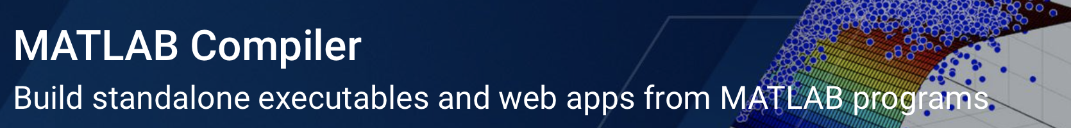
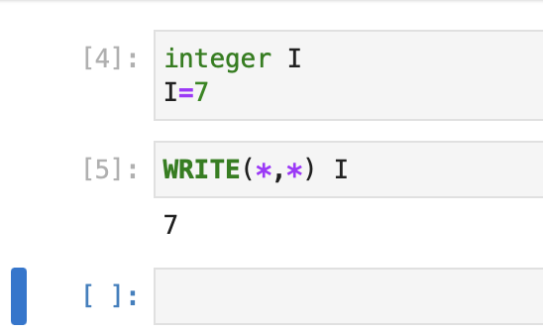
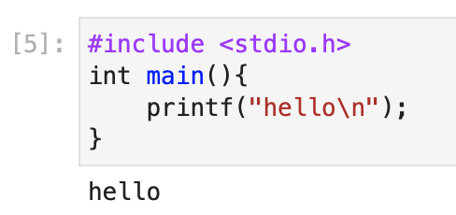
Compiled languages v. interpreted - II
  Quite a few languages are a bit of both – compiled v interpreted workflow is different, but language can be the same
    For example, Matlab has a compiler that can be used to generate executables that can be run on systems without Matlab installed.
    Fortran and C can be written in a Notebook
© 1994-2025 The MathWorks, Inc. All rights reserved. This
content is excluded from our Creative Commons license. For
more information, see https://ocw.mit.edu/help/faq-fair-use.
https://github.com/jupyter/jupyter/wiki/Jupyter-kernels
Notes:
https://lfortran.org: conda install jupyter lfortran

Slide 9
We will focus on compiled languages that are commonly used in science
Fortran, C, C++
Some common compiled language aspects
  Much more use of explicit “types”
  More fiddly syntax
  Edit, compile, run workflow is similar
    make and build tools etc….
Some differences between Fortran, C, C++
  Syntax is different, although concepts (loops, functions, conditionals) the same
  Fortran has a numerical/scientific feel builtin (for example native multi-dimensional arrays)
  C, C++ are a little more general computing oriented (pointers, memory management etc…)

Slide 10
Getting started with C
Quick look at basics of language
compiler, make tools etc…
Try compiling, running, modifying some examples

Slide 11
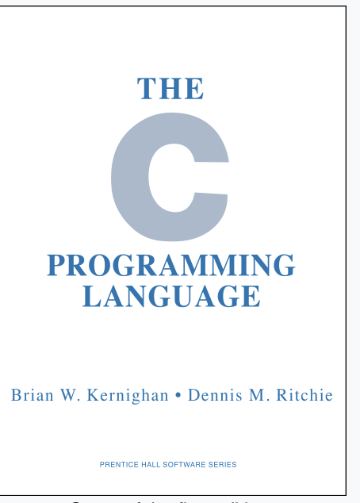
Getting started with C
C programming language originally designed in late 1960s, early 1970s.
  first popularized as “Kernighan and Ritchie” (K&R) C in 1978. Part of UNIX OS,
  much of UNIX (and subsequently Linux, Windows, MacOS etc..) in C
  1989 introduced ANSI C, a more official standard ( with standards board etc..).
  Latest is C17 (around 2017)
  C is very portable, and very widely used. Almost every flavor of hardware has a C compiler.
    Not all hardware supports all features
    Features beyond basic library are in a standard library (https://en.wikipedia.org/wiki/C_standard_library ).
© 1996–2025 Pearson. All rights reserved. This content is
excluded from our Creative Commons license. For more
information, see https://ocw.mit.edu/help/faq-fair-use.

Slide 12
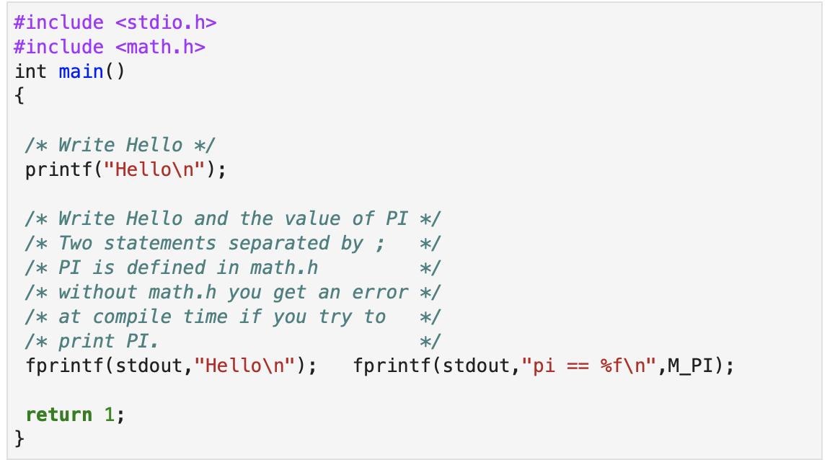
Getting started with C
A simple C program.
“Included” header files - cpp
All programs start from the main() function.
Executable statements always end in “;”
Comments /* .. */ or //
printf(…), fprintf(…) are function calls (for I/O) from standard library.
stdout, M_PI are from “header”
All functions (including main() ) can return some result

Slide 13
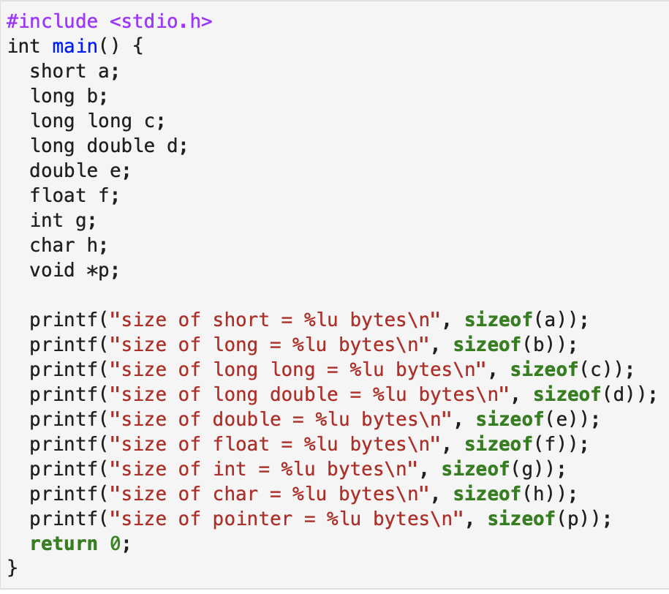
Getting started with C
Everything in C needs to “typed”
Key primitive types
int, float, double, char, * (pointer type).

Slide 14
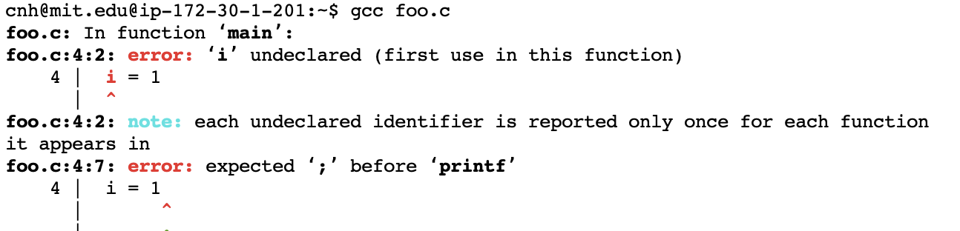
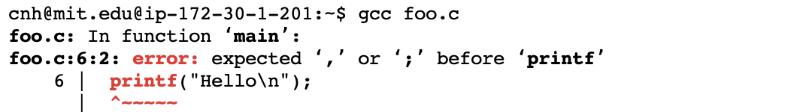
Getting started with C
Generally compiled languages are “fussier” over syntax.
Compiler gives error, because I didn’t declare the variable “i” to be an integer.
Compiler gives error, because I forgot a “;” at the end of the line.
The more exacting syntax rules can make writing code more awkward, but they help the compiler generate optimized code.

Slide 15
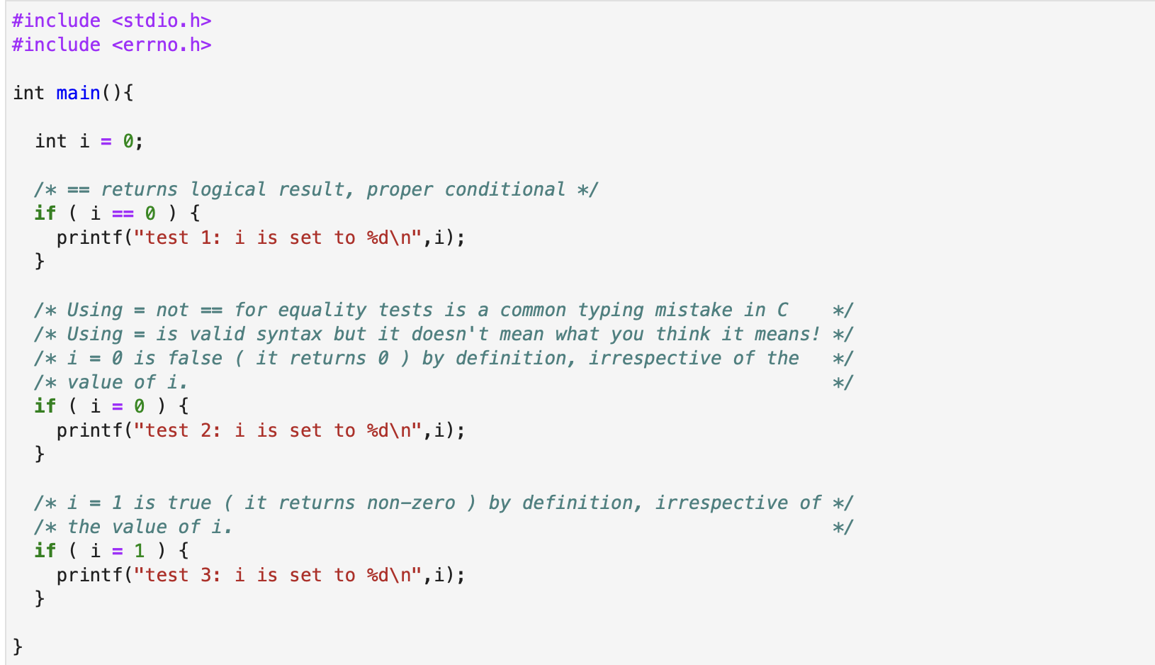
Getting started with C
Conditionals in C
== is used to test for equality.
= is used for assignment. It returns the value assigned – so can be false (==0) or true (==1) depending on assigned value.
If statement syntax is
if ( condition ) {
expression;
} else {
expression;
}
else part is optional.

Slide 16
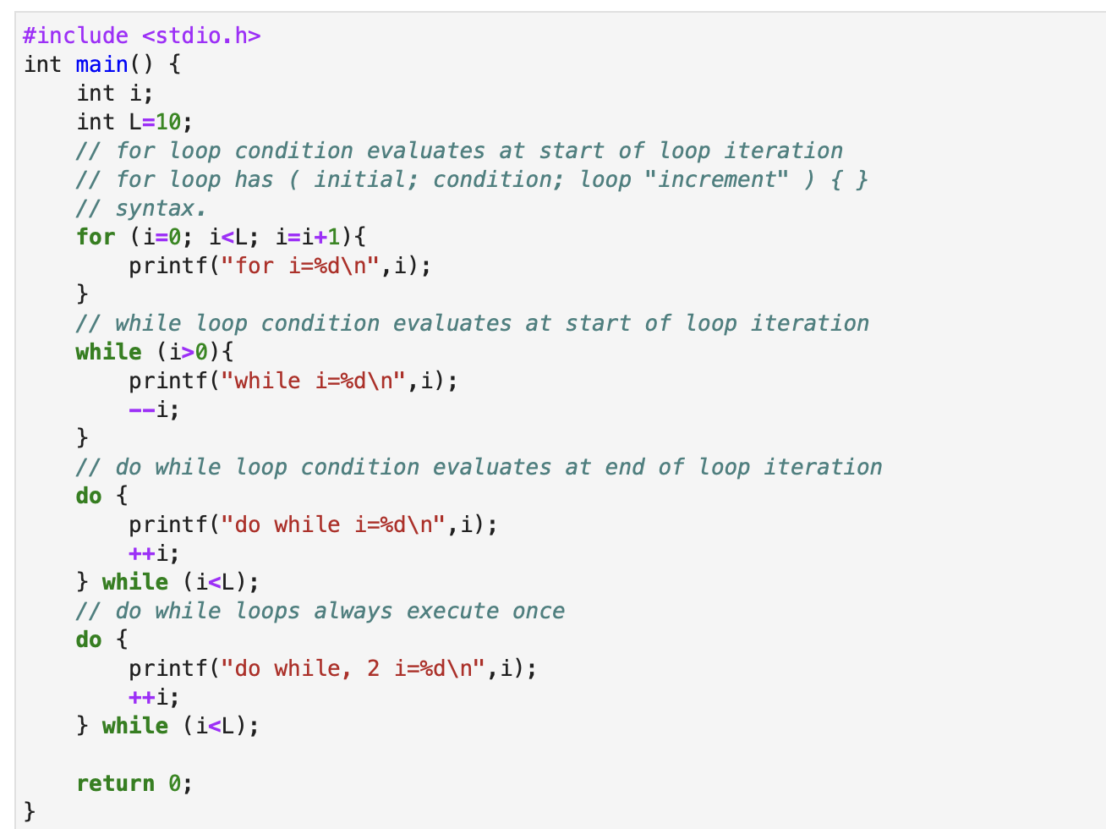
Getting started with C
Loops in C
Python – loops indented.
C syntax
for ( start; test; iteration_update ) {
expression;
}

Slide 17
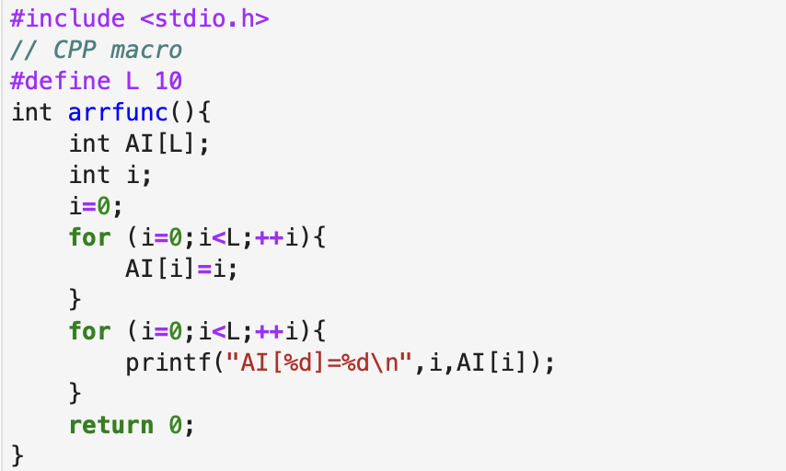
Getting started with C
Arrays in C
Arrays in C – simple way with [] notation.
Array sizes in simple way need to be set at “compile” time.
Arrays can be multi-dimensional.

Slide 18
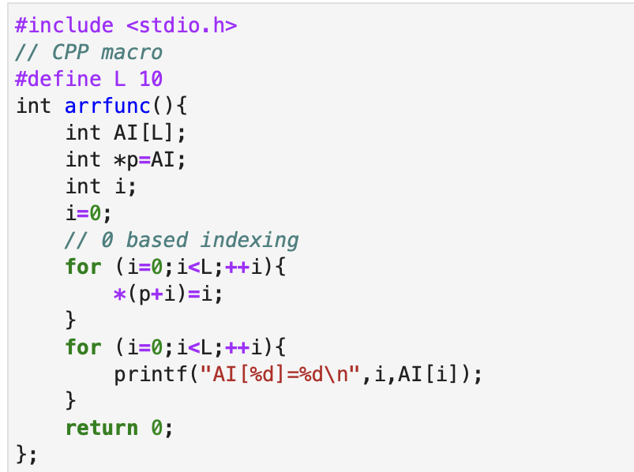
Getting started with C
Arrays in C are pointers
Arrays in C are one example of “pointers”
Pointers are often used in C and can be a bit mysterious to start.
In essence they are a “pointer” to some block of memory.

Slide 19
Getting started with C
Hands on
  Lec13-c-basic-hello.ipynb
  But need C Kernel installed for this to run (and maybe only possible on Unix and Mac)
When this code is loaded (at least in vscode) there should be a prompt to install the C/C++ extension pack.
For Macs:
xcode-select --install
(invokes getting the command line)
https://github.com/fxcoudert/gfortran-for-macOS/releases
(Then use gcc).
Run in athena.dialup.mit.edu (needs two-factor authentication).

Slide 20
MIT OpenCourseWare
https://ocw.mit.edu
12.010 Computational Methods of Scientific Programming, Fall 2024
For more information about citing these materials or our Terms of Use, visit https://ocw.mit.edu/terms.

