Slide 1
12.010 Computational Methods of Scientific Programming
Lecture 18: Finish C++, Classes in Python

Slide 2
Overview
C++ Inhertance
Classes in Python

Slide 3
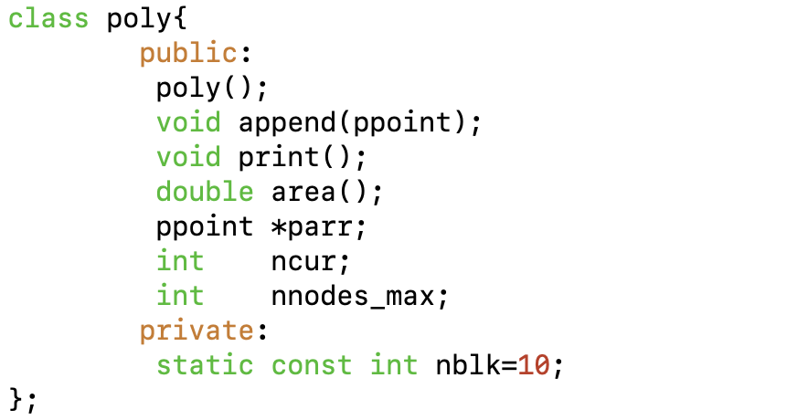
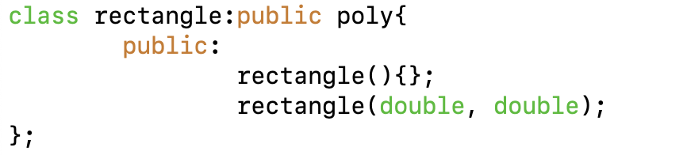
C++ inheritance
A widely used and useful feature of C++ is inheritance
  inheritance supports creating a class that is the “child” of one or more other classes
  as name suggests, the ”child” class by default inherits functions/data types from its “parent(s)”
  code shown declares a rectangle:: class that is a child of poly::
  the public elements of poly:: are public in rectangle::

Slide 4
C++ inheritance
Inheritance means that rectangle:: has append(), area() and print() methods from poly::
By using inheritance, we can create a special case of poly:: for rectangles and reuse the poly:: code.

Slide 5
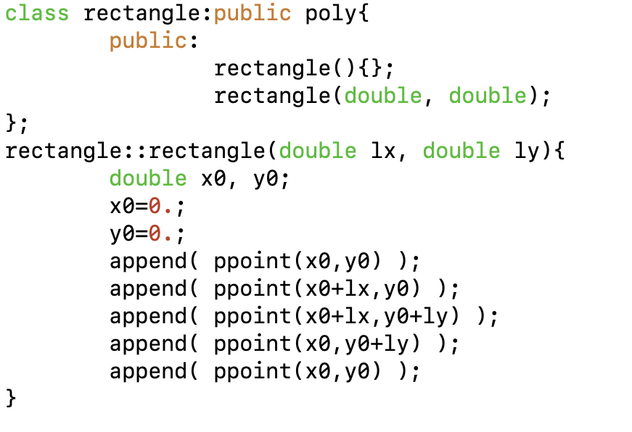
C++ inheritance
The rectangle:: class only needs to define its own “constructor”.
Everything else can be reused from poly::
In the constructor we use the append() method to create a poly:: that is rectangular with size given by arguments lx and ly.

Slide 6
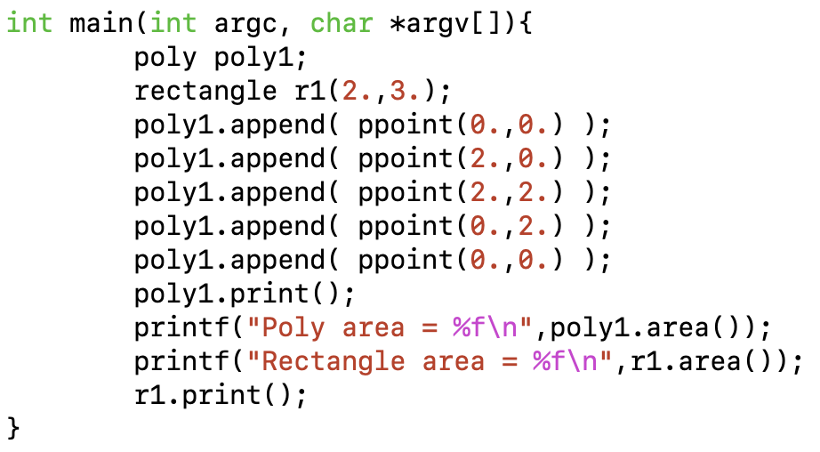
C++ inheritance
In our toy main program we can create a rectangle and use the poly:: methods area() and print() directly with the rectangle:: instance.

Slide 7
C++ inheritance
Try Lec19_poly_area_inherit.cc
  See if you can create a triangle child class.

Slide 8
C++ summary
Classes plus inheritance, polymorphism (same function name different behavior with type/class) and overloading (change meaning of e.g. +) are main elements of object oriented programming.
C++ also provides a standard library that has some pre-built classes for common activities e.g. arrays, strings, random numbers etc…
A much larger community library “boost” (https://www.boost.org ) holds many more standard sets of functions for C++.

Slide 9
Classes and namespaces in Python*
Material here is in Lec19_classes.ipynb
Scope:
  global: available in main workspace
  nonlocal: available within nested functions (i.e., only defined within scope of nested functions.
Class: Defines a new class with normally (but not always):
  __init__ method that is invoked when an instance of a class is created.
  def of methods always includes self as first argument.
Instances override attributes set in the class definition
Inheritances: Class definition includes reference to another class (or classes in python)
Iterators revisit
Concept here is instance of class contains both data and methods associated with class. Functions: Pass information through calling arguments; classes information imbedded in instance of class.

Slide 10
MIT OpenCourseWare
https://ocw.mit.edu
12.010 Computational Methods of Scientific Programming, Fall 2024
For more information about citing these materials or our Terms of Use, visit https://ocw.mit.edu/terms.

