Slide 1
12.010 Computational Methods of Scientific Programming
Lecture 19: Julia

Slide 2
Julia programming language
  Python, Matlab high-level, interpreted, can be fast but can be very slow for e.g. loops.
  R - great at statistics, but sloooow.
  C, C++, Fortran fast, compiled, but not very interactive, old style very pedantic syntax.
  Julia tries to fuse good features and leave out undesirable qualities

Slide 3
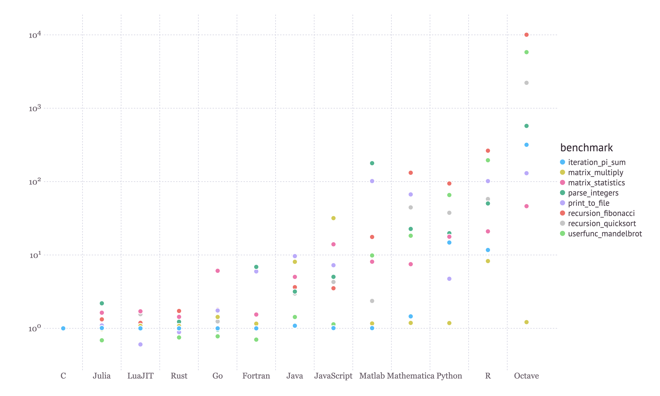
Julia relative performance
Plot shows relative performance of some computing micro-benchmarks in different languages.
Julia is an interpreted/JIT language but is competitive with compiled languages. (JIT – just in time compiled).
JIT means that we can work interactively, but code (in functions) will be compiled on the fly
Compiled code is cached so one time compile overhead can be amortized.
© 2024 JuliaLang.org contributors. All rights reserved. This content is excluded from our Creative Commons license. For more information, see https://ocw.mit.edu/help/faq-fair-use.

Slide 4
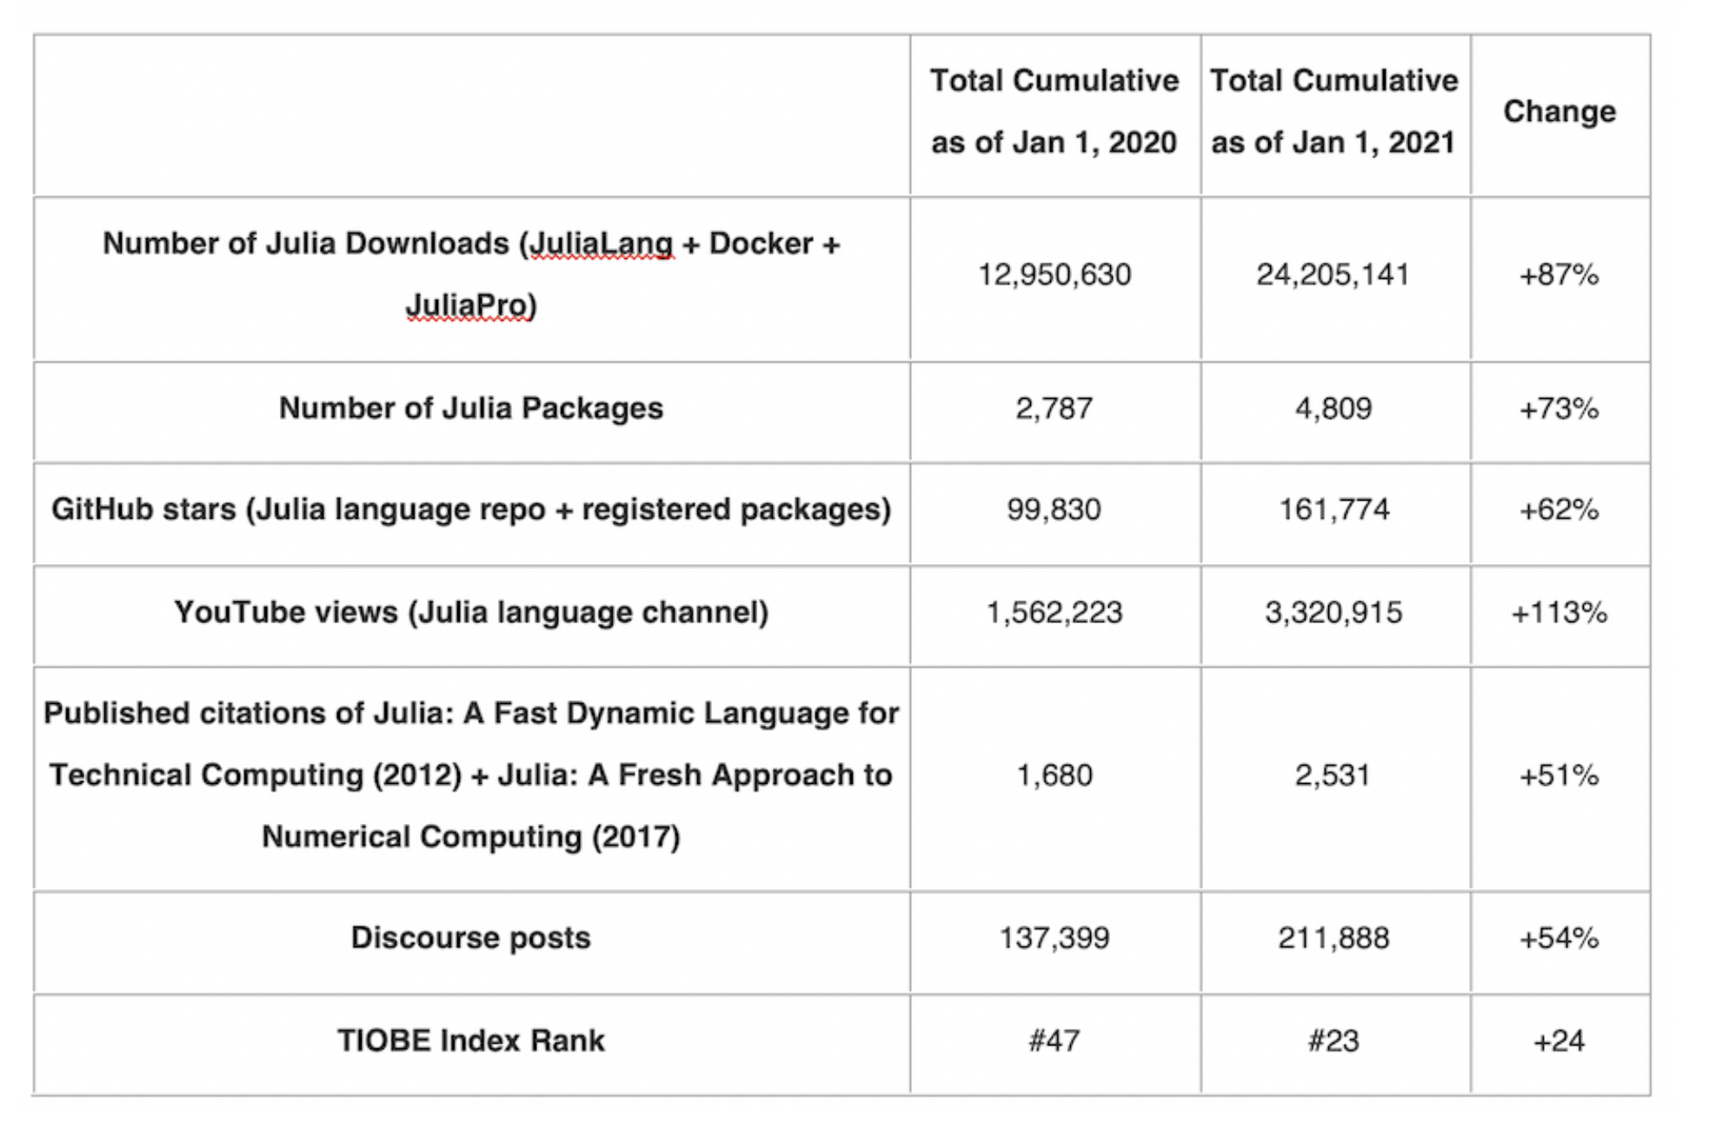
Julia uptake
Still much less widespread than Python, R, Matlab
But growing
Mostly interoperable with Python packages (via “PyCall” and/or PyPlot – Matplotlib optimized interface).

Slide 5
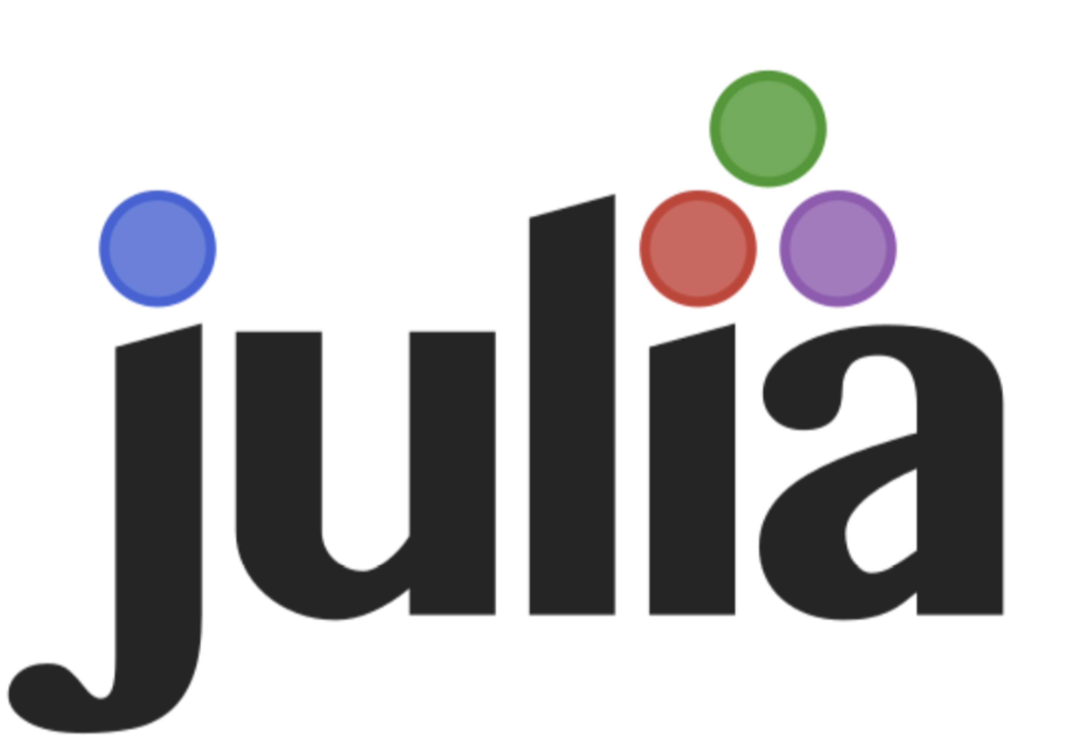
Julia history
Named origin ~2009 MIT, Jeff Bezanson, Alan Edelman, Stefan Karpinski, Viral Shah.
Some heritage of numerous “parallel matlab” projects dating bak to at least 1995.
V1.0 release 2018.
Some interesting things
  Arrays are arrays (no numpy, lists etc..)
  Types support different style of work
    Interactive, but loops can be fast
    Functions have some nice syntax
  Strong support for mathematical ideas
© 2024 JuliaLang.org contributors. All rights reserved. This content is excluded from our Creative Commons license. For more information, see https://ocw.mit.edu/help/faq-fair-use.

Slide 6
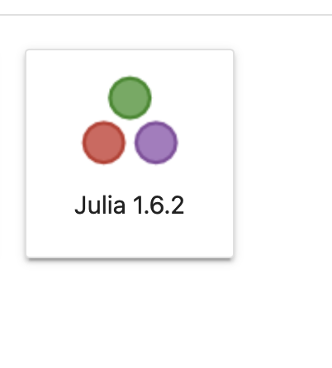
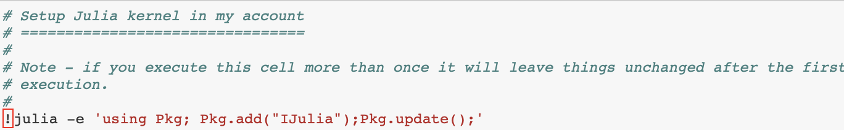
Julia getting set up
© 2024 JuliaLang.org contributors. All rights reserved. This content is excluded from our Creative Commons license. For more information, see https://ocw.mit.edu/help/faq-fair-use.
Try install in Python notebook Julia/account_configadd_julia_kernel.ipynb
  this should add
or on laptop ( download ) and try “REPL”

Slide 7
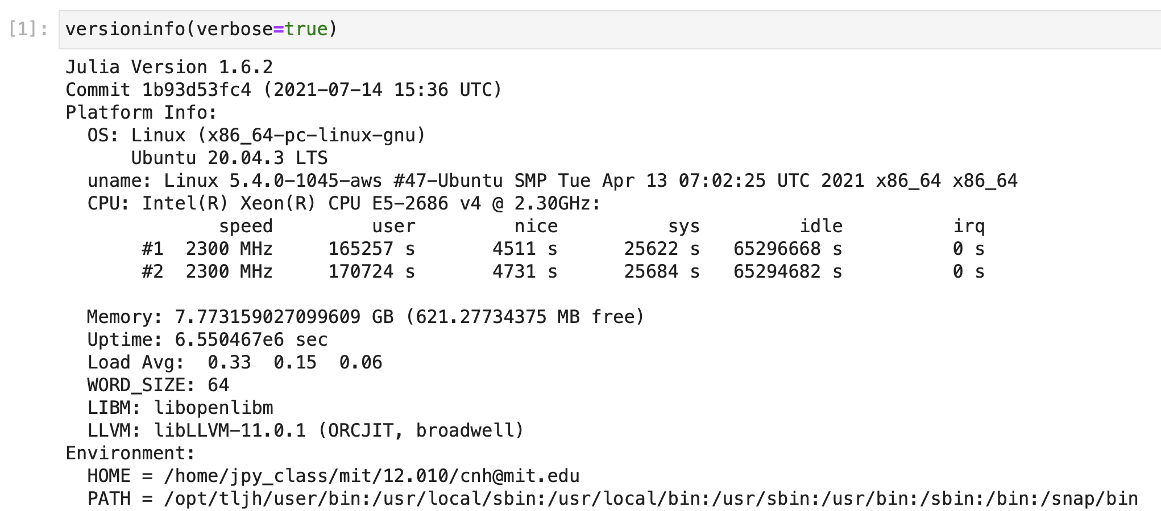
Julia notebook
First command in a notebook takes a few seconds. Julia compiles everything to cache on the fly, and a lot of Julia itself is in Julia e.g.

Slide 8
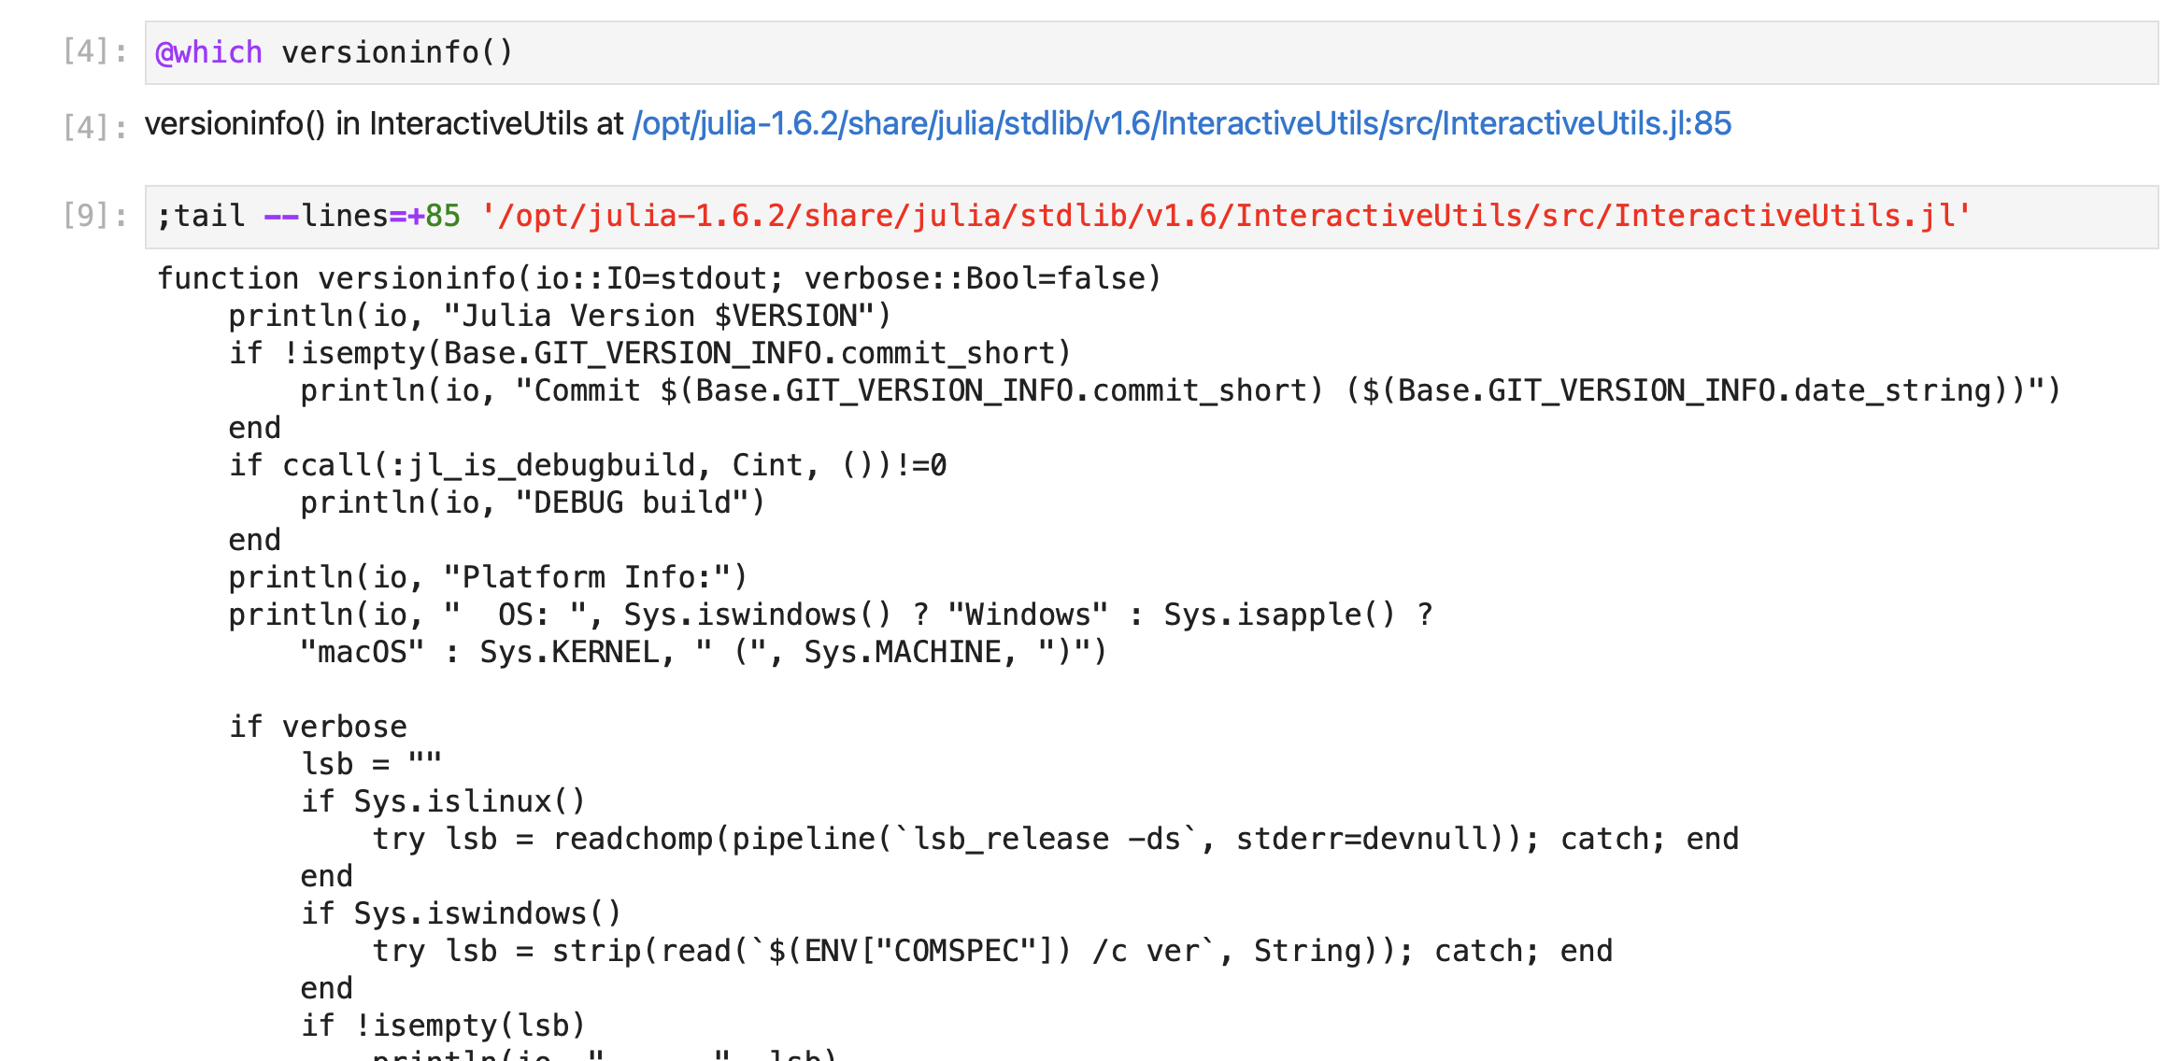
Julia notebook

Slide 9
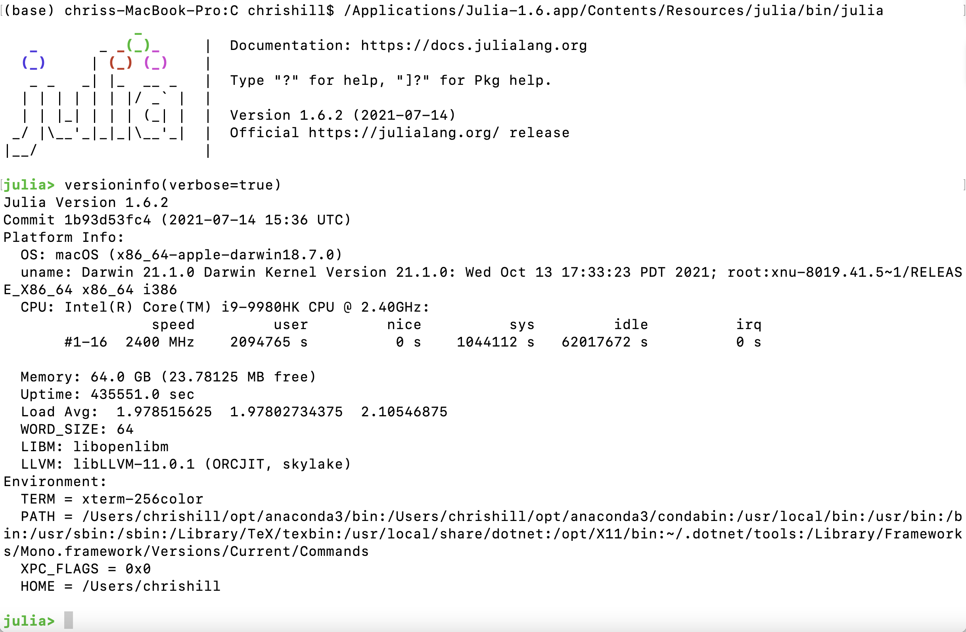
Julia REPL
Running “REPL” from a shell.

Slide 10
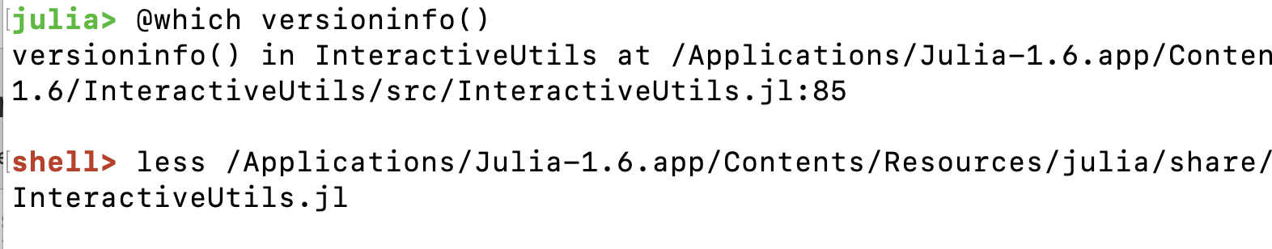
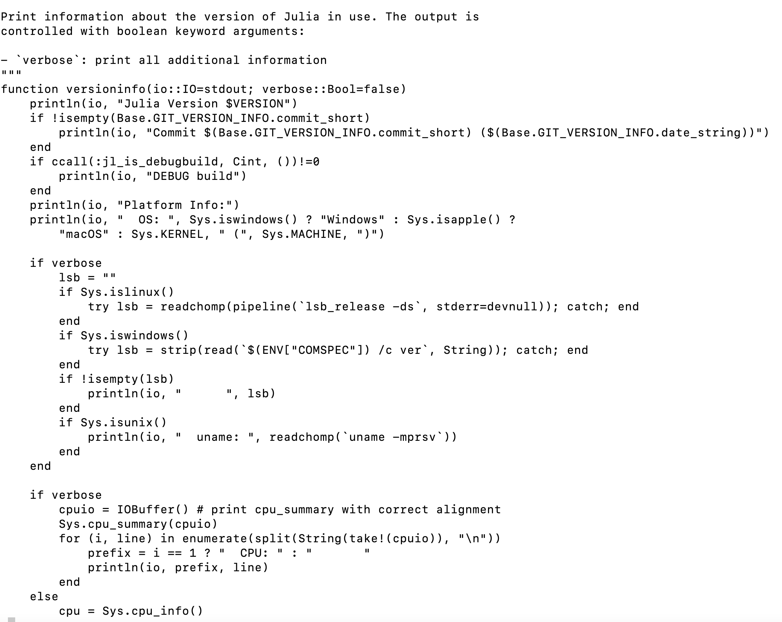
Julia REPL
Running “REPL” from a shell.

Slide 11
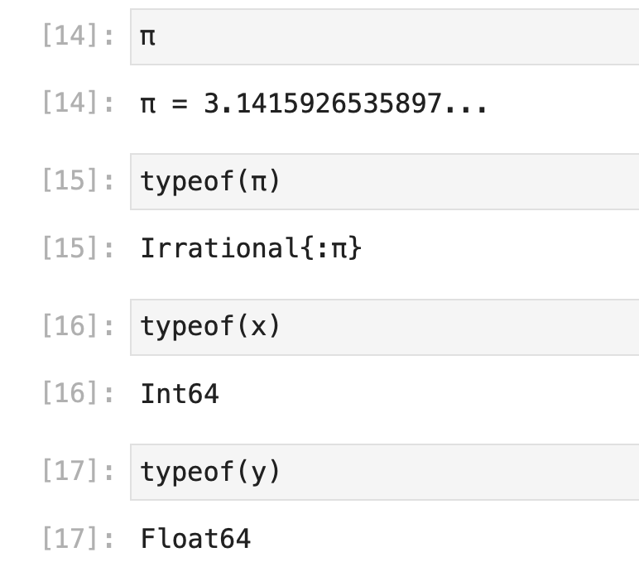
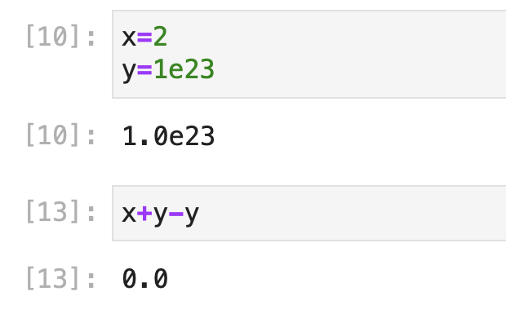
Julia basic math is much like python, C, Fortran etc…
Everything is typed, but types are inferred when they can be.

Slide 12
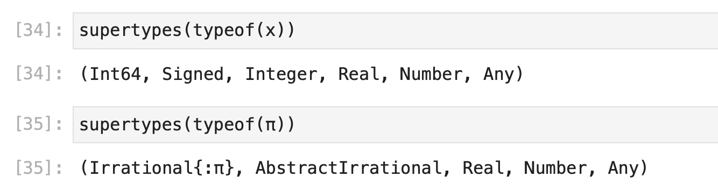
Julia types are very organized and central to language

Slide 13

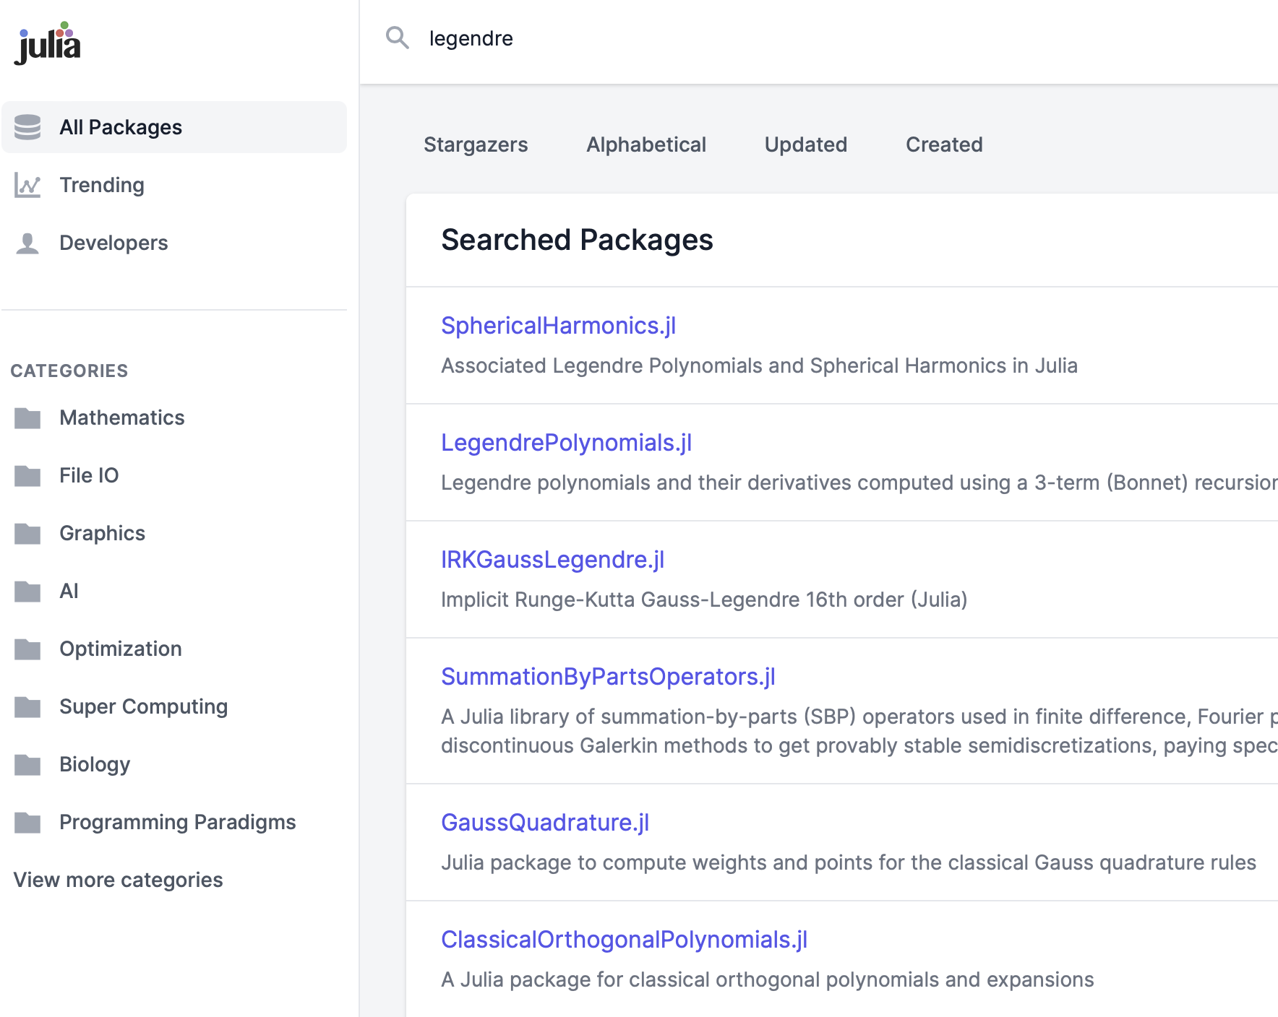
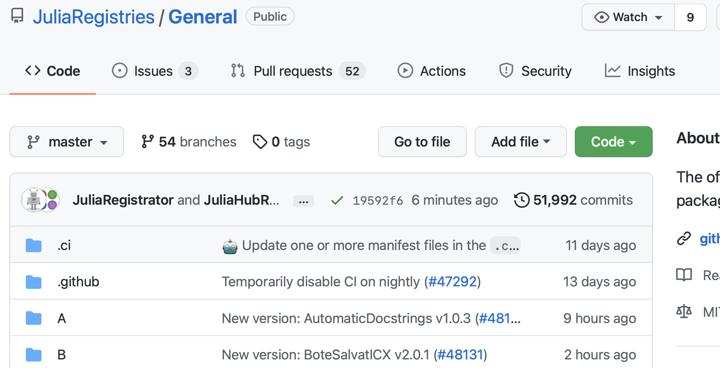
Julia has a builtin package ecosystem that has > 4000 packages/modules
https://juliapackages.com
© 2024 JuliaLang.org contributors. All rights reserved. This content is excluded from our Creative Commons license. For more information, see https://ocw.mit.edu/help/faq-fair-use.
© 2025 GitHub, Inc. All rights reserved. This content is excluded from our Creative Commons license. For more information, see https://ocw.mit.edu/help/faq-fair-use.

Slide 14
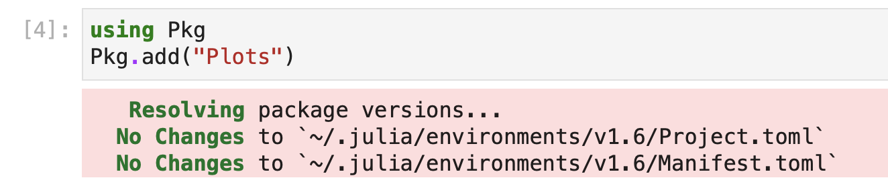
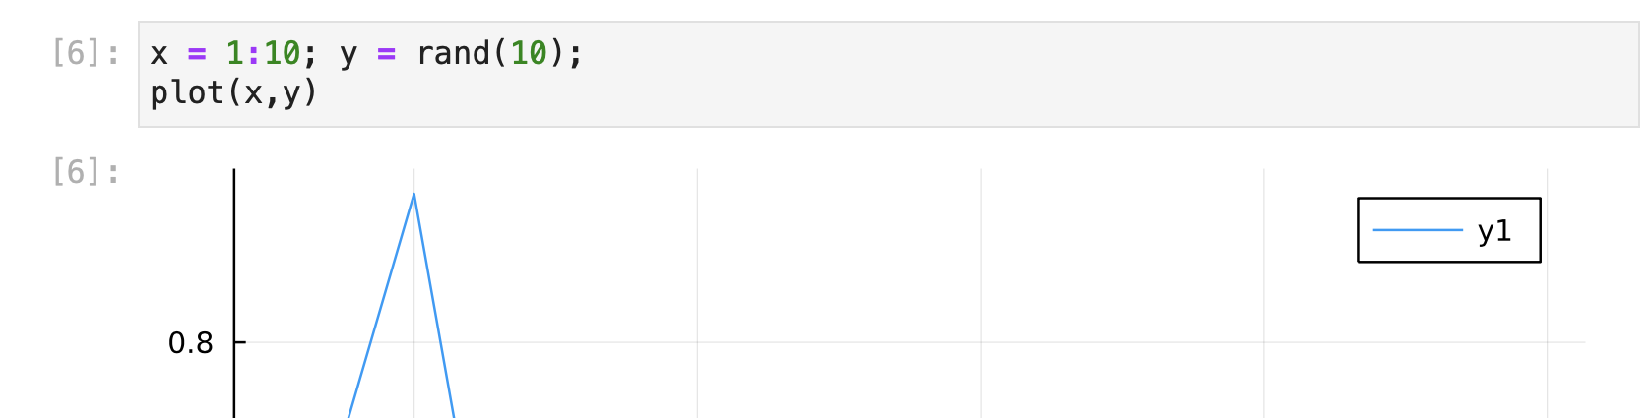
Julia package syntax is multi-stepped
Pkg.add is a bit like conda install in Python. Once a package is added no need to install again.
Need to Pkg.add() before can import with “using”.
using NAME is similar to “import” in Python

Slide 15
Julia basic syntax
Some online resources
  https://juliadocs.github.io/Julia-Cheat-Sheet/
  https://juliabyexample.helpmanual.io
Basics notebooks
  account_configadd_julia_kernel.ipynb
  Lec20_julia_basics.jl
  julia-basics.ipynb

Slide 16
MIT OpenCourseWare
https://ocw.mit.edu
12.010 Computational Methods of Scientific Programming, Fall 2024
For more information about citing these materials or our Terms of Use, visit https://ocw.mit.edu/terms.

