Slide 1
12.010 Computational Methods of Scientific Programming 2021
Lecture 21: Parallel programming. Algorithms and scaling, MPI

Slide 2
Summary
Parallel programs
  Examples
  Amdahl Law
  Gustafson Law
Implementation in MPI
  MPI concepts and basics
  Python and MPI example
  Other tools
    Threads
    Interesting builtin Fortran parallelism!

Slide 3
Explicitly Parallel Programs
All programs are parallel at some level
  CPU does a lot of things at once but hides from application.
  For example, in a single threaded program a CPU might execute multiple independent instructions in parallel. This is hidden from application.
Explicitly parallel programs
  Application is written so parallelism (multiple things potentially/actually happening at same time) is part of the program code
  Parallelism is visible to the application and programmer.

Slide 4
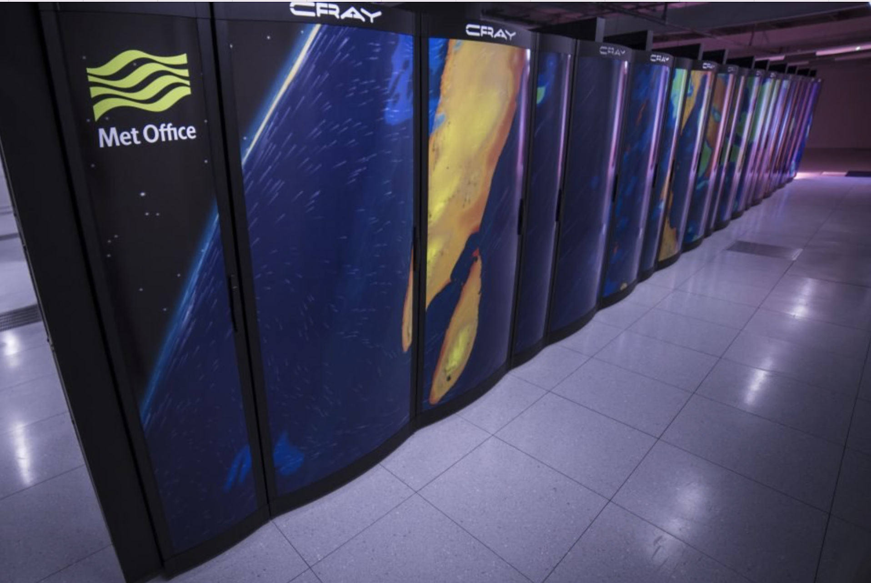
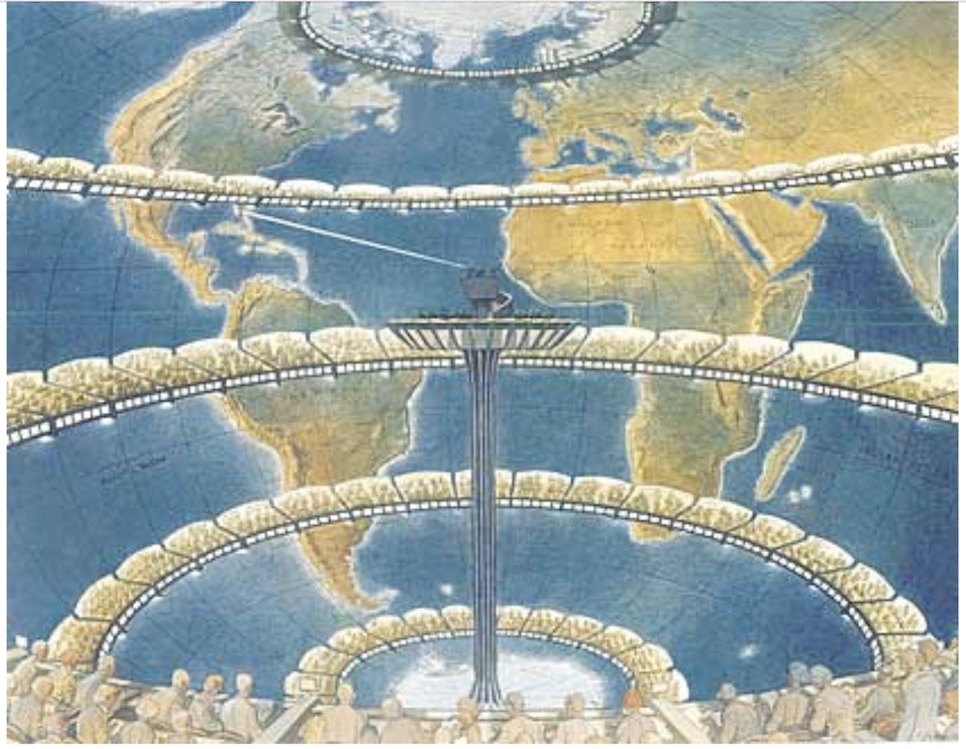
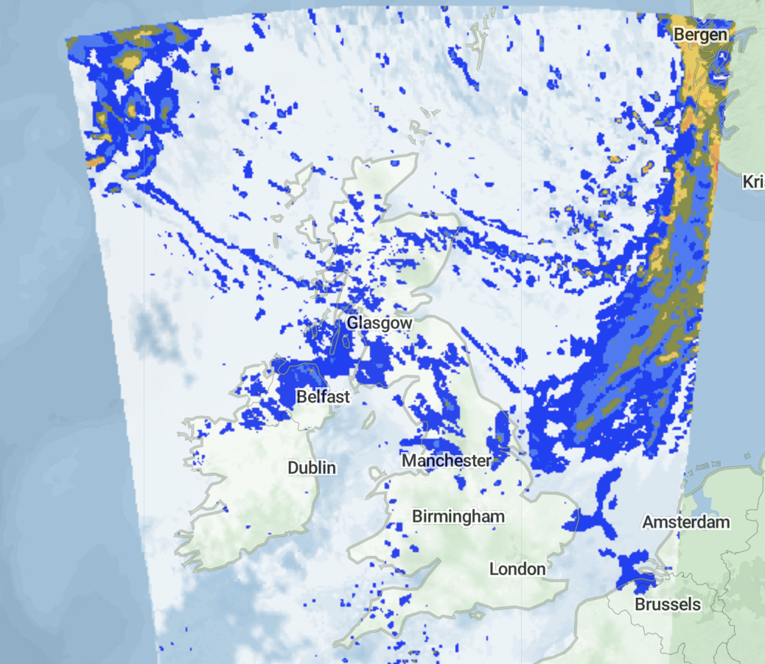
Examples
© Microsoft. All rights reserved. This content is excluded from our Creative Commons license. For more information, see https://ocw.mit.edu/help/faq-fair-use.
Weather forecasts.
2021 actual
~50,000 CPU cores
© OpenMapTiles. All rights reserved.
This content is excluded from our Creative Commons license. For more information, see https://ocw.mit.edu/help/faq-fair-use.
1922 proposal (L.F. Richardson)
~64,000 human computers
© Francois Schuiten. All rights reserved. This content is excluded from our Creative Commons license. For more information, see https://ocw.mit.edu/help/faq-fair-use.

Slide 5
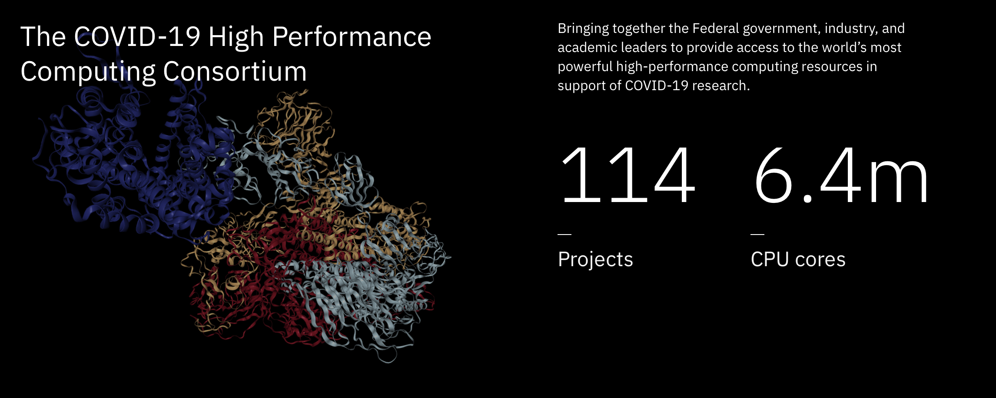
Examples
© Source unknown. All rights reserved. This content is excluded from our Creative Commons license. For more information, see https://ocw.mit.edu/help/faq-fair-use.
Atomistic modeling, protein folding, pharmaceutical binding strength, aerosol dispersion, epidemiological modeling, genetic sequence correlation, phylogenetics, etc…

Slide 6
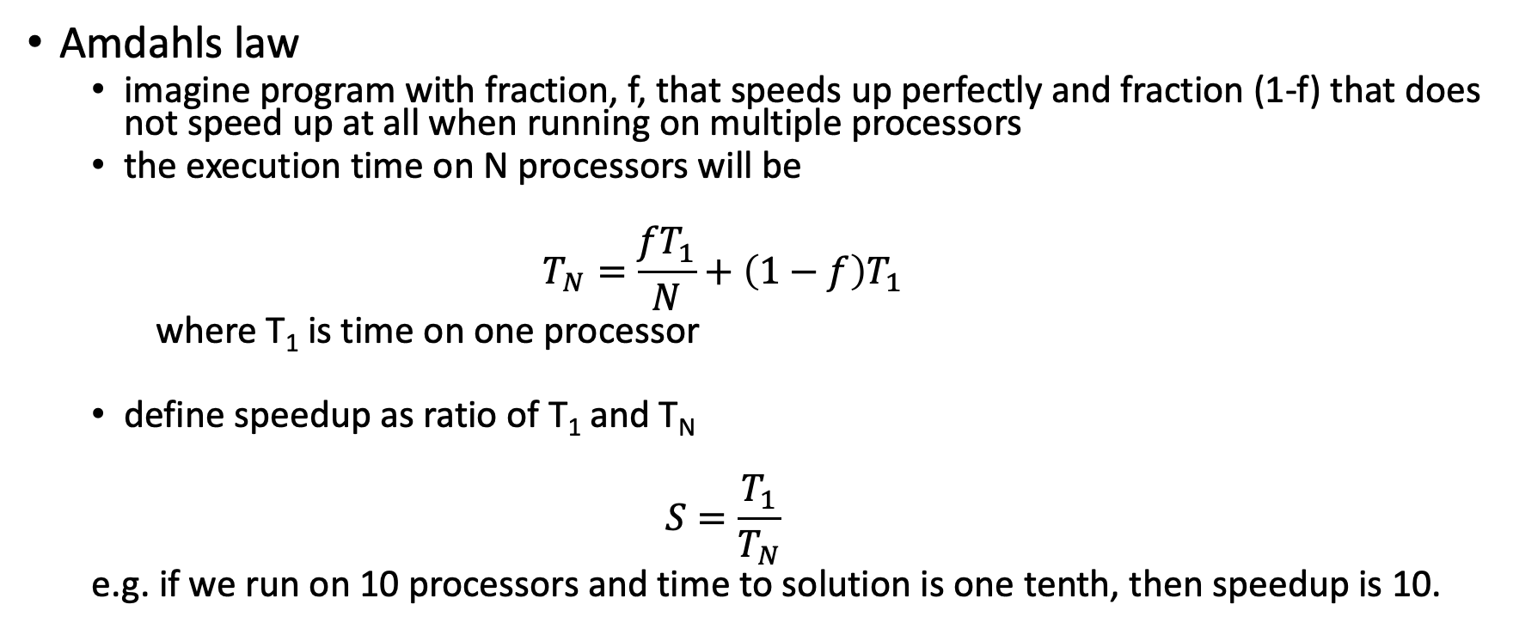
When is parallelism useful?
Amdahls law
  imagine program with fraction, f, that speeds up perfectly and fraction (1-f) that does not speed up at all when running on multiple processors
  the execution time on N processors will be
  $$T_{N}=\frac{{fT}_{1}}{N}+\left(1−f\right)T_{1}$$
  where T₁ is time on one processor
  define speedup as ratio of T₁ and T_{N}
  $$S=\frac{T_{1}}{T_{N}}$$
  e.g. if we run on 10 processors and time to solution is one tenth, then speedup is 10.

Slide 7
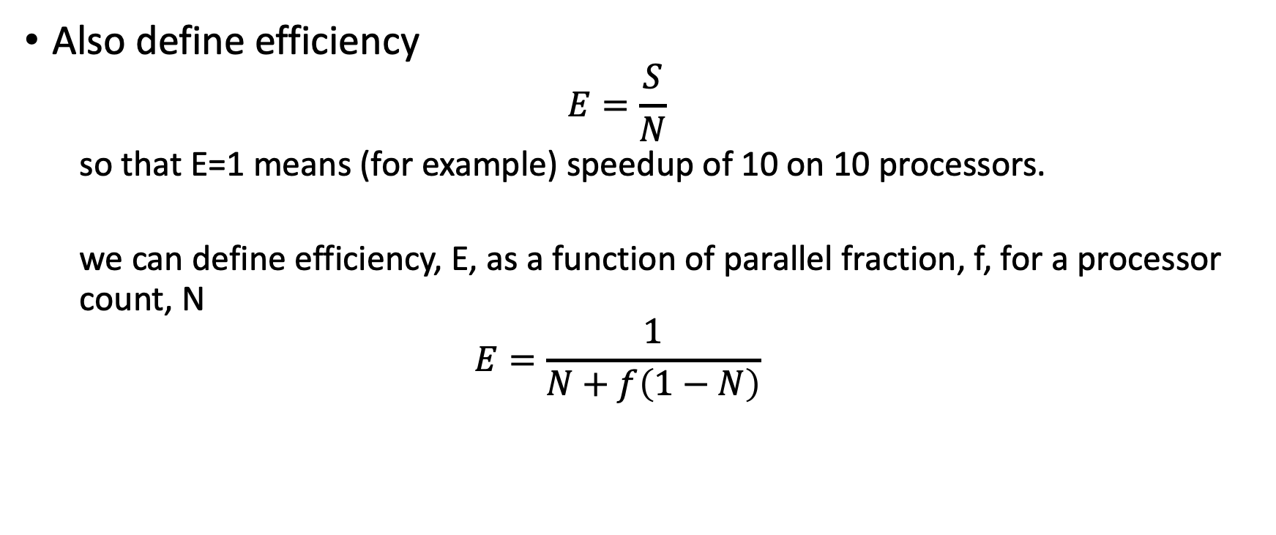
How does speedup vary as parallel fraction varies?
Also define efficiency
  $$E=\frac{S}{N}$$
  so that E=1 means (for example) speedup of 10 on 10 processors.
  we can define efficiency, E, as a function of parallel fraction, f, for a processor count, N
  $$E=\frac{1}{N+f\left(1−N\right)}$$

Slide 8
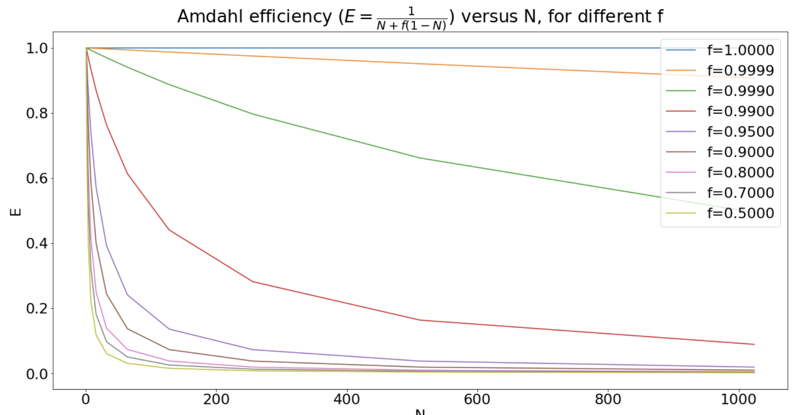
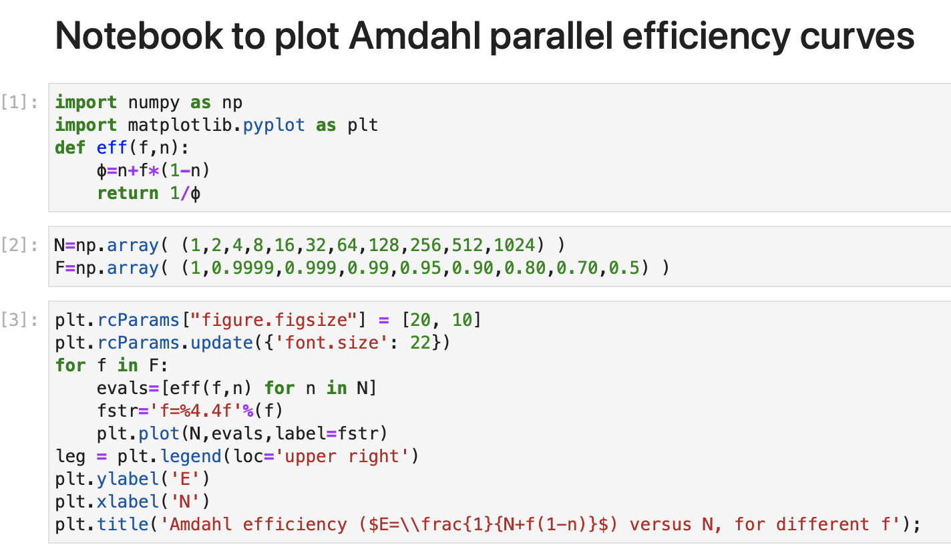
Plotting efficiency for N and f
Amdahls characterizes “strong scaling” i.e. efficiency when problem size is held constant.
In reality, weather, molecular dynamics etc… run larger problems on larger computers such that f increases.

Slide 9
Gustafsons Law v Amdahl
Amdahls characterizes “strong scaling” i.e. efficiency when problem size is held constant.
In reality, weather, molecular dynamics etc… run larger problems on larger computers such that f increases. This is called weak scaling.
Gustafsons law expresses a weak scaling speedup relation
In reality many real problems in scientific will exhibit some combination of strong and weak scaling.
i.e.
they are not completely fixed in size
and
they can not be sensibly grown forever
$$S_{w}=s+\left(1−s\right)N=N+\left(1−N\right)s$$
where s is the fraction of the program that runs serially.
In Gustafsons law speedup increases with N, because the serial fraction becomes a smaller part of the overall work.

Slide 10
Handson
fall-2021-12.010/lec22/amdahl.ipynb

Slide 11
Writing parallel programs with MPI
Writing an explicitly parallel program involves using extra language syntax that expresses parallel operations.
There are multiple tools for doing this. The most common one in scientific computing is a library called the “Message Passing Interface” (MPI).

Slide 12
Programming with MPI
MPI - “message passing interface” is a very popular tool for writing parallel programs in scientific and technical computing.
Lots of information can be found at
  https://www.mpi-forum.org/docs/
Work on standard began in 1992.
Three generations of standards MPI 1.2, MPI 2.0 and MPI 3.1
  MPI 1.2 very widely available
  MPI 2.0 widely available
  MPI 3.1 generally available
  MPI 4 under construction

Slide 13
Role of MPI
Supercomputing
  Most big supercomputing applications (weather/climate, materials/atomic, folding, massive ML) use MPI
    HPC simulators often use MPI directly, or indirectly (through e.g. ScalaPack, MAGMA etc…)
    ML applications often use MPI indirectly e.g. through Horovod et….
  MPI can be used from C, C++, Fortran and from Python, Julia, Octave, Matlab and R.
  It is the dominant tool for “tightly” coupled parallel codes on clusters and in cloud settings.
  It can run on laptop, local clusters and on massive supercomputers.
  It can work with CPU and/or GPU codes.
  All the shared resources at MIT have MPI available.
  MPI basics are minimalist and relatively easy to learn. Quite a bit of work is left to application developer to create an MPI program.

Slide 14
Basic hardware and programming model
CPU
Typical Hardware
Some communication fabric e.g. network, shared memory etc…
CPU
CPU
MPI Programming Model
P0
MPI library for communicating between independent processes.
P1
P2

Slide 15
Ingredients of MPI
P0
MPI Programming Model
MPI library for communicating between independent processes.
P1
P2
Some way to start up multiple processors
Some way to figure out which process is which
Some way to send information between and amongst processes
Some way to synchronize between processes
These ingredients are provided by library calls and by a special script for starting a program. Both are provided by MPI.

Slide 16
MPI Hello World
P0
MPI Programming Model
MPI library for communicating between independent processes.
P1
P2
Some way to start up multiple processors
  MPI_Init()
Some way to figure out which process is which
  MPI_CommRank()
  MPI_CommSize()
MPI_Init(), MPI_CommRank and MPI_CommSize are MPI library calls. Each has online documentation.

Slide 17
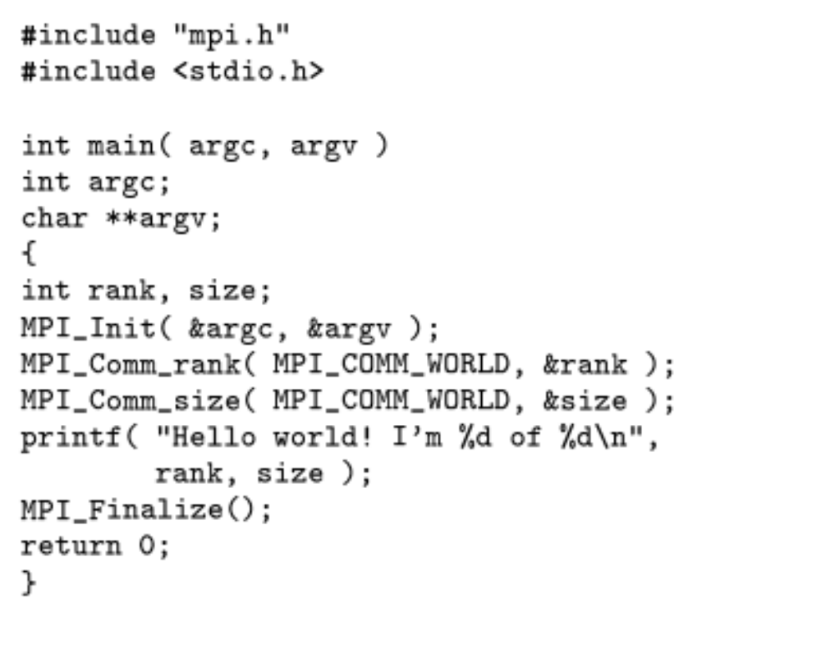
MPI Hello World – “classic MPI”
Running in parallel after this, state before is undefined.
Each MPI process will get a different rank value. Ranks are in range 0 – (N_{p}1)
Everybody gets size = N_{p}

Slide 18
Hands on
fall-2021-12.010/lec22/mpi-hello.c
fall-2021-12.010/lec22/*py
Notes:
To here 11/30/2021.

Slide 19
Beyond Python MPI
MPI also exists for C, C++, Fortran, Julia, R etc…
Python Dask is an alternate for parallelism that tries to be more integrated with Python.
Modern Fortran (2008) is a parallel language without any extensions using “co-arrays”.

Slide 20
Hands on
fall-2021-12.010/lec22/*py

Slide 21
Hands on
fall-2021-12.010/lec22/coarray.F90

Slide 22
MIT OpenCourseWare
https://ocw.mit.edu
12.010 Computational Methods of Scientific Programming, Fall 2024
For more information about citing these materials or our Terms of Use, visit https://ocw.mit.edu/terms.

