Slide 1

Teaching with Sustainability
A course offered during IAP - January 2022
Instructors:
Liz Potter-Nelson and Sarah Meyers
Environmental Solutions Initiative at MIT

Slide 2
Overview of Topics
Week 1 - What is sustainability education?
Defining sustainability using the Brundtland Report & sustainability education
Brief timeline of education to accomplish sustainability initiatives
Explanation of a Jigsaw Activity
Jigsaw activity of foundational sustainability documents
Week 2 - What is effective teaching?
Effective teaching is complex
Learning theories provide a framework for how people learn
Theoretical perspectives used in sustainability education
Sustainability Learning Approaches
Positivism vs Postpositivism
Positivism and Postpositivism Activity
Practicality of Sustainability Education
Week 3 - How do we teach sustainably?
Asset vs Deficit Approaches
Criticism of US Education
Bloom’s Taxonomy
Sustainability education looks to paradigm shifts
Levels of implementing sustainability
Level 1, Level 2, Level 3
Transitioning through Sustainability Levels
Week 4 - What does this look like for me?
Explanation of Categories of Sustainability Literacy Competencies
Explanation of Sustainable Instructional Approaches
Overview of Understand by Design (UbD)
Modified UbD template
Sticking Points

Slide 3
What is Sustainability Education?
Week 1

Slide 4
Teaching with Sustainability
Quick Overview
The goal of this class is to provide participants with the opportunity to connect sustainable pedagogies with their teaching practices (current or future).
At times we’ll ask you to reflect on the practices that we are using during these sessions
  Participant - Learning and building knowledge
  Observer - Reflecting on how we are teaching
One of the best ways to engage in learning is to fully participate

Slide 5
Introductions
Who are you?
Please share the following about yourself:
  Preferred first name
  What do you do?
  Why are you interested in this class?
  What is something that is exciting for you and you could talk for hours about?
2 minutes to generate ideas, we’ll model how to respond, before asking for volunteers, everyone will get a chance to share! (You can type your responses in the chat if that is more comfortable for you)

Slide 6
Introductions
Let’s break it down…
Why do you think we did this activity?
What were some ways we supported participants in this activity?
What are other ways we could have supported participants in this activity?

Slide 7
Learning Objectives for Today
Participants will get a foundational view of sustainability education
Participants will begin to situate sustainability education within their professional practice

Slide 8
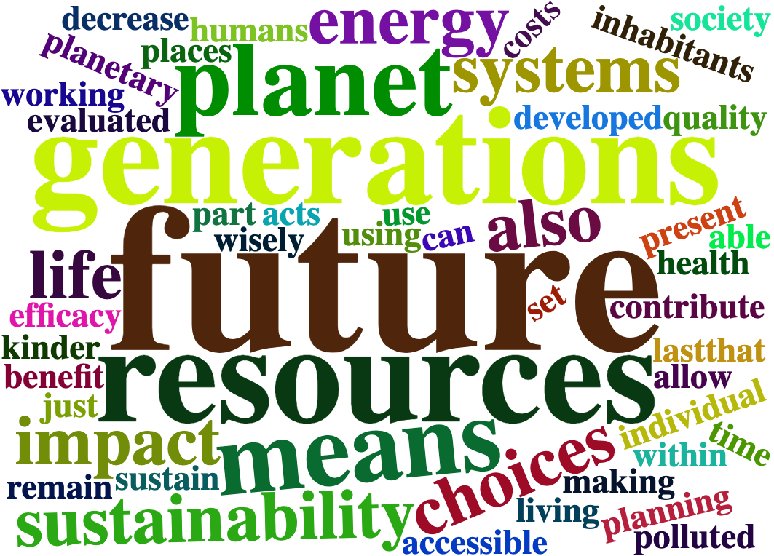
What Does Sustainability Mean to You?

Slide 9
Common Definition
The Our Common Future Report, commonly referred to as the Brundtland Report shares two important understandings around sustainability:
Sustainable Development is "development that meets the needs of the present without compromising the ability of future generations to meet their own needs."
Identifies the following 3 components of sustainable development: environmental protection, economic growth, and social equity
https://sustainabledevelopment.un.org/content/documents/5987our-common-future.pdf

Slide 10
Sustainability
Sustainability emerged not as a discipline but as field focused on solving complex wicked problems that are interconnected socially, environmentally, and economically

Slide 11
Sustainability Education
Sustainability education works to creating sustainability literate individuals – people who not only know about sustainability but are able to embody the knowledge, skills and dispositions of sustainability
Transforming systems of thinking and learning.

Slide 12
Brief Timeline -
Education to Accomplish Sustainability Initiatives
1987 | Our Common Future Report (Brundtland Report) | Defined sustainable development
1992 | United Nations Conference on Environment and Development (Rio Summit, Earth Summit) | Chapter 36 of Agenda 21 identified the critical role of education, training, and public awareness in achieving sustainable development
2000 | Release of the Earth Charter | The Earth Charter is a collaborative document which articulates a worldwide vision for, and the steps necessary to accomplish a sustainable future
2000 | Millennium Development Goals | Goal of ending worldwide poverty
2005 | UN Decade of Education for Sustainable Development (DESD) | Goal of incorporating sustainable development into education systems
2014 | Global Action Program (GAP) on ESD | Continued the work of DESD by identifying five priority action areas, and four strategies in an effort to support the SDGs
2015 | Sustainable Development Goals (SDGs) | 17 goals which were identified to build a blueprint for a better and more sustainable future for all

Slide 13
Jigsaw Activity -
Foundational Documents
Jigsaw Activity
  Work with a group to unpack something (in this case an article) and then share that knowledge with a different group of people to build a collective, group understanding
  Examples of Classroom Uses:
    Readings (Chapters of a Book; Articles)
    Learning new content (Ex - Families on Periodic Table)

Slide 14
Jigsaw Activity -
Foundational Documents
Jigsaw Activity - Foundational Documents - Preview
  Part 1 - Time to read individually & answer questions
  Part 2 - Work as a group to answer questions & unpack article
  Part 3 - Move to new groups to learn about other documents
  Part 4 - Large group debrief of documents

Slide 15
Jigsaw Activity -
Part 1
Take 15 minutes to read your article and work to answer the questions.
  Do what you need to do to be successful in reading your document.
Work to answer the questions, individually
Extra time is yours to stretch, rest your brain, etc.

Slide 16
Jigsaw Activity -
Foundational Documents
Group 1: Earth Charter
  Read all
Group 2: Roadmap for Implementing the GAP on ESD
  Read print pages 14-25
Group 3: Our Common Future Report
  Read print pages 5-9
Group 4: Education for SDGs Learning Objectives
  Read print pages 1 and 6-8
Group 5: Education 2030 Incheon Declaration and Framework for SDG 4
  Read print pages pages 7-11

Slide 17
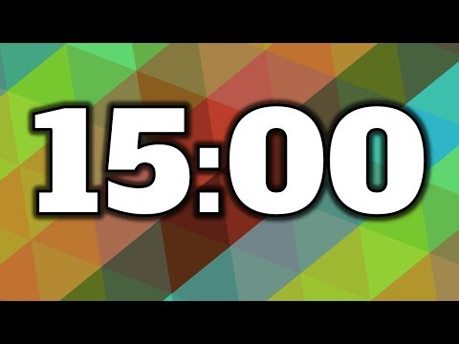
Jigsaw Activity -
Foundational Documents
Questions to Answer
Who wrote the document?
When was the document written?
What do you think the document asking people to accomplish?
What effect do you think the document has had on education, either intended or unintended?
How does the document connect to your professional practice?
What questions do you have after reading this excerpt?

Slide 18
Jigsaw Activity -
Part 2
Debrief as a group
Brief introductions
10ish minutes to work through the answers with your group
Consider - what do you want to share with others about your document?
Before you leave you group, make sure that everyone has a different letter…A, B, C, D, E

Slide 19
Jigsaw Activity -
Part 3
New Groups
15ish minutes to share about your documents with your new groups
If time permits:
What commonalities are there in these documents?
What differences/competing ideas are there in these documents?
How do these documents connect to your professional practice?

Slide 20
Jigsaw Activity -
Part 4
Reflect as a large group
What commonalities do you think are in these documents?
What differences/competing ideas are there in these documents?
How do you think these documents connect to your professional practice?

Slide 21
Pause for Pedagogy
Let’s unpack the Jigsaw Activity:
How could you use an activity like this in your professional practice?
What were strengths of this activity?
What barriers could there be for participants?
What value is there in including the phrase “do you think” in a question for students?

Slide 22
Review of Learning Objectives
Participants will get a foundational view of sustainability education
Participants will begin to situate sustainability education within their professional practice
What did you learn today?
How will people you interact with know and benefit?

Slide 23
Preview of Next Week
Next week we’ll look at education research to understand effective teaching practices.
We’ll also work to identify our goals for students and how to tie our goals to our instruction

Slide 24
MIT OpenCourseWare
https://ocw.mit.edu
RES.ENV-006 Teaching with Sustainability IAP 2022
For more information about citing these materials or our Terms of Use, visit https://ocw.mit.edu/terms.

